Slide 1
Community Name
Month, Day, Year
1

Slide 2

Outline
Potential Sources of Lead Exposure
Vulnerable Populations
Impacts and Effects of Lead Exposure
Taking Action
2
Notes:
During today’s session we will discuss:
Potential Sources of Lead Exposure;
Vulnerable Populations
Impacts and Effects of Lead Exposure; and
How you can take action to reduce and prevent exposure to lead

Slide 3

Introduction
How many of you have ever heard of lead or lead poisoning before today?
What are some things you have heard about lead or lead poisoning?
Does anyone know what year their house or apartment was built; was it before or after 1978?
3
Notes:
I. Introduction
You may have heard of lead or lead poisoning before today but may not know much about it. Our goal today is for you to walk away with an understanding of lead. We will learn:
What lead is;
Where lead is found;
How lead can harm both children and adults; and
Potential impacts on the environment, wildlife and cultural practices.
Please keep in mind that lead exposure and lead poisoning are preventable – we can take actions to reduce potential exposure to lead, and there are laws in place to protect us. At the end of this session, we will discuss several actions we can take as a community and as individuals to reduce potential lead exposure. At the end of this session, we will discuss several actions we can take as a community and as individuals to reduce potential lead exposure.
Before we begin, I have a few questions for the group to gain a better understanding of what you already know about lead and lead poisoning
1. How many of you have ever heard of lead or lead poisoning before today? Instructor Note: This can be as simple as having participants raise their hands or respond with “yes” or “no” or you can allow participants time to share specific stories.
2. What are some things you have heard about lead or lead poisoning? Instructor Note: This is another good time to allow participants to share specific pieces of information and/or stories.
3. Does anyone know what year their house or apartment was built; was it built before or after 1978? For those of you who live in a house or apartment built before 1978, this session is going to provide you with information about lead-based paint that may be in your home.

Slide 4
What questions do you have about lead and lead poisoning?
4
Notes:
Let’s make a list of questions you have about lead and the health impacts of being exposed to lead with the hope that by the time we get to the end of today’s session we will have covered and answered all of your questions. If you do not have a question right now, you can ask them later or come up and add them to the list.
Instructor Note: Allow participants time to think and then type their questions. Choose a couple to highlight and maybe answer or say we will be talking about that in just a little bit.
We should be able to answer most of these throughout today’s session and, if not, we will jot them down and answer them later on.

Slide 5
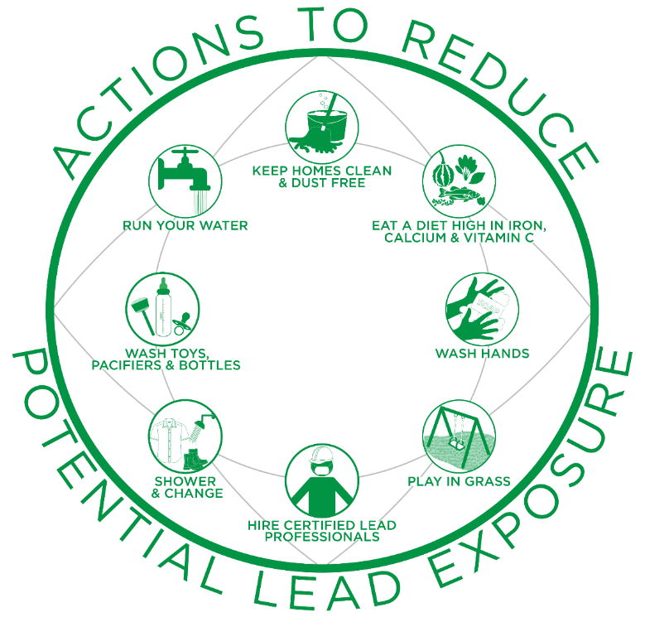
Clean your home once a week using a clean, wet or damp cloth, sponge or mop to minimize dust, which may contain lead.
Flush your home’s pipes by running your tap, taking a shower or doing a load of laundry or dishes before drinking or cooking.
Eat a well-balanced diet with foods high in calcium, iron, and vitamin C to help reduce the absorption of lead.
Wash daily any items your child uses regularly, such as pacifiers and toys, to minimize exposure to dust, which may contain lead.
Use soap and water (warm or cold) to wash children’s hands several times a day, especially after playing outside or with animals.
Change and wash clothes, remove shoes and shower to avoid tracking lead into the home from soil, work sites, or hobbies.
Play in grass and dirt not contaminated with lead, and use designated picnic, camping and hiking areas.
Hire a certified lead professional when renovation, repair or painting will disturb painted surfaces in a home built before 1978. Keep family out of the work area.
5
Notes:
ANIMATED SLIDE – Text boxes will appear in order when each click occurs.
I would like to acknowledge that the information we are covering today may seem alarming, but when we become aware of and educated on this subject, we are empowered to take preventative action to safeguard our health. Preventing lead exposure in young children (under age six) is especially important because as their bodies grow and develop, they are more vulnerable to the permanent harmful impacts of lead. As parents, grandparents, community leaders, and other community members who care about your community’s wellbeing, we can take simple actions right now to prevent lead exposure, which at the same time can benefit the overall health of our land and our families. Exposure to lead is preventable!
Let’s start by going over the image on the front of the worksheet. The image shows simple actions we can take to reduce potential exposure to lead.
These are: the 8 Actions to Reduce Potential Lead Exposure, they include the following: (pause briefly between each to give translators time)
1. Clean your home once a week using a clean, wet or damp cloth, sponge or mop to minimize dust, which may contain lead.
2. Eat a well-balanced diet with foods high in calcium, iron and vitamin C to help reduce the absorption of lead in the body.
3. Use soap and water (warm or cold) to wash children’s hands several times a day, especially after playing outside or with animals.
4. Play in grass and dirt not contaminated with lead, and use designated picnic, camping and hiking areas.
5. Hire a certified lead professional when renovation, repair or painting will disturb painted surfaces in a home built before 1978. Also, it’s important to keep family out of the work area.
6. Change and wash clothes, remove shoes and shower to avoid tracking lead into the home from soil, work sites, or hobbies.
7. Wash daily any items your child uses regularly, such as pacifiers and toys, to minimize exposure to dust, which may contain lead.
8. Flush your home’s pipes by running your tap, taking a shower or doing a load of laundry/dishes before drinking or cooking.
These are just a few of the actions we can take to reduce our potential exposure to lead. Later in this session, we will revisit these actions and learn more.

Slide 6
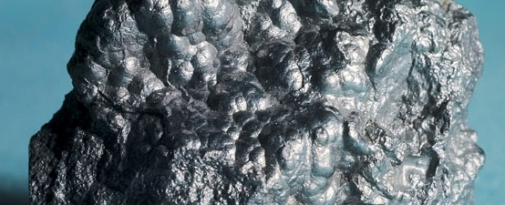
http://mfritz8science.wikispaces.com/file/view/lead_1.jpg/262242078/lead_1.jpg
What is Lead?
Bluish-gray metal found in small amounts in the earth’s crust
Impossible to identify with the naked eye
Does not biodegrade or disappear from the environment over time
6
Notes:
II. Potential Sources of Lead Exposure
What is Lead?
Lead is a naturally occurring bluish-gray metal found in small amounts in the earth’s crust.
Lead is mined and then used in products to make them durable and last longer.
Once lead is used in a product, it is nearly impossible to identify with the naked eye.
Lead does not biodegrade or disappear from the environment over time.

Slide 7
Where do you think lead can be found?
7
Notes:
b. Where is Lead Found and How is it Used?
Lead has been mined and used for a long time and can be found in many different products and places.
Where do you think lead can be found? Take a moment to glance around the space you are in and think about your everyday activities. Pencils may come to mind, but they are made with graphite and not lead.
Instructor Note: Give participants time to think. If they are unable to think of something, you can either prompt them by suggesting items or simply state: “Don’t worry if you cannot think of something. Today we will learn where lead is found and how to prevent exposure.”

Slide 8

Lead can be found in…
All parts of our environment:
  Air
  Soil
  Water
  Inside our homes
8
Notes:
Unfortunately, lead can be found in all parts of our environment – the air, soil, water and even inside our homes.
Much of our exposure comes from human activities involving the use of fossil fuels, past use of leaded gasoline, some types of industrial facilities (e.g., mining and manufacturing), leaded aviation fuel, and past use of lead-based paint in homes.
Congress has passed several laws related to lead. These laws address lead in paint, dust and soil; lead in the air; lead in water; and disposal of lead waste. As a result, these laws limit the amount of lead that can be in products, outdoor air, emissions from some industrial sources, waste waters and more.

Slide 9
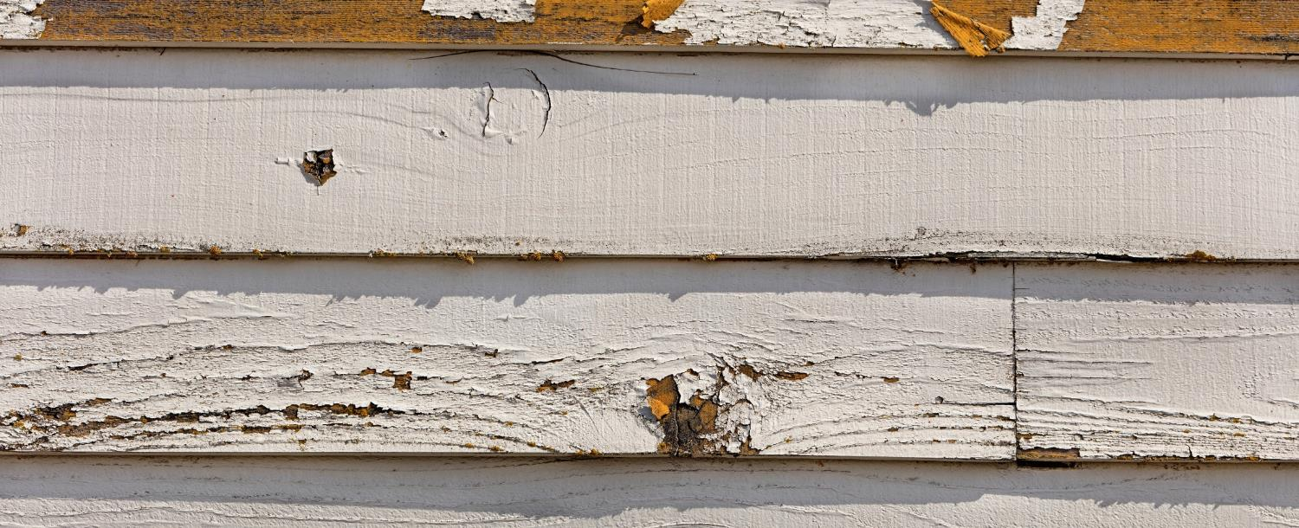
Lead-based Paint
Found in older homes built before 1978
Major source of exposure when not maintained
  i.e., peeling, chipping, cracking
Chips and dust can scatter and become a hazard
  These hazards can be breathed in or swallowed by children, residents and workers
9
Notes:
Historically, lead compounds were added to paints to enhance color, reduce corrosion, or shorten drying time.
Lead-based paint, if present in older homes built before 1978, may be a major source of exposure to lead to those who live there. When painted surfaces are not properly maintained, paint can deteriorate, peel, chip, chalk, or crack. When lead-based paint is old and worn or is subject to constant rubbing (as on doors and windowsills), lead-based paint chips and dust can scatter and become a hazard. These hazards can be breathed in or swallowed by children, residents, and workers. Lead dust can also be scattered when paint is disturbed during renovation, repair, or remodeling activities.

Slide 10

Children can be exposed…
Through lead-based paint chips and dust in buildings & homes when they put toys, fingers, and other objects in their mouth.
When licking or biting chewable lead-based paint surfaces
Lead-based paint has a “sweet” taste
10
Notes:
Today, one of the most common ways children can be exposed to lead is through contact with lead-based paint chips and dust in buildings and homes that have lead-based paint present when they put toys, fingers and other objects in their mouths as part of their normal behavior. Lead-based paint has a "sweet" taste, which makes it appealing to young children, so they may also lick or bite chewable lead-based paint surfaces.

Slide 11

Childhood lead exposure and lead poisoning is preventable!
When lead-based paint is in good condition and not on an impact or friction surface, it is usually not a hazard
Keep children from coming into contact with lead
11
Notes:
When lead-based paint is in good condition and is not on an impact or friction surface, like a window, the paint is usually not a hazard. Childhood lead exposure and lead poisoning from lead-based paint and other sources is preventable. The key is to keep children from coming into contact with lead. Throughout today we will discuss how to limit contact with lead to prevent exposure.

Slide 12

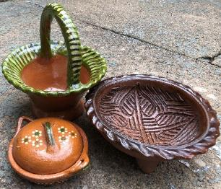

Potential Sources of Exposure
Painted farm equipment and boats
Imported pottery, candles, older mini blinds
Toys
Ceramicware
Solder
Batteries
Ammunition
Old cellphones in disrepair
Cosmetics
Photo by Randy Fath on Unsplash
Imported pottery from Mexico
Toy Recall from https://www.cpsc.gov/Recalls/2007/rc2-corp-recalls-various-thomas-friends-wooden-railway-toys-due-to-lead-poisoning
12
Notes:
Lead and lead compounds have been used in a wide variety of products found in and around our homes, including paint used on some farm equipment and boats; imported pottery, scented candles and older mini blinds; glassware; toys; ceramicware; solder; batteries; ammunition; old cell phones that are in disrepair, and cosmetics (e.g., lipstick).

Slide 13
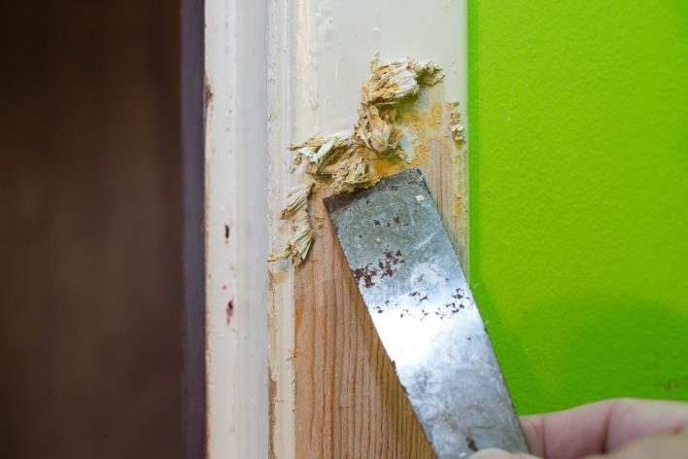
Potential Sources of Exposure
Any renovation, repair, or painting project in a pre-1978 home can easily create dangerous lead dust
Hire a lead-safe certified contractor: epa.gov/lead/findacontractor
Or follow DIY lead-safe work practices: epa.gov/lead/rrp-diyers
Notes:
While renovation projects can be fun and rewarding, they can also expose you and your family to lead if your home was built before 1978. Any renovation, repair, or painting (RRP) project in a pre-1978 home can easily create dangerous lead dust, which can harm children and adults.
Dangerous lead dust can be created when these surfaces are disturbed or demolished during RRP projects, increasing the risk of lead exposure. Because of this risk, EPA recommends owners of pre-1978 homes hire lead-safe certified contractors who are trained in lead-safe work practices for home renovations. People who perform renovations themselves should take simple precautions and use do-it-yourself (DIY) lead-safe work practices to keep themselves and others safe from potential lead exposure.
Visit epa.gov/lead/findacontractor to find a certified renovator near you or visit epa.gov/lead/rrp-diyers for information on DIY lead-safe work practices.

Slide 14
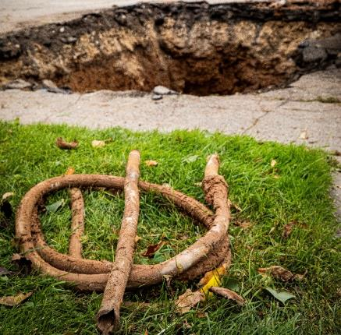

Potential Sources of Exposure
Lead can enter drinking water when plumbing materials that contain lead corrode
www.epa.gov/protectyourtap
  Lead pipes
  Faucets
14
Notes:
Lead can enter drinking water when plumbing materials that contain lead corrode.
The most common sources of lead in drinking water are from lead pipes, faucets and fixtures.
Lead pipes are more likely to be found in older cities and homes built before 1986. You may be wondering if it is safe to take a bath or shower using water suspected of containing lead. The answer is yes. Bathing and showering should be safe for you and your children, even if the water contains lead. Human skin does not absorb the lead in water.
To help you determine if you have a lead service line bringing water into your home, visit epa.gov/protectyourtap.

Slide 15
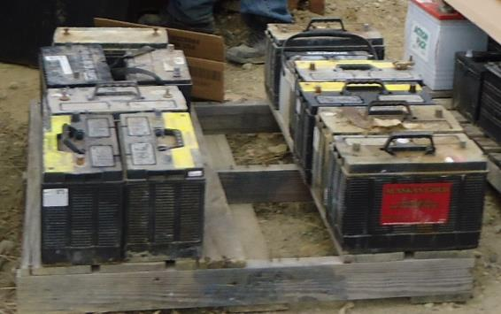
Potential Sources of Exposure
Industrial sources and contaminated sites
Improper disposal/recycling of lead-acid batteries
Improper storage of metal parts
Abandoned mines
Photo provided by Zender Environmental and Health Group
15
Notes:
Lead can be released into the environment from industrial sources and contaminated sites, such as former lead smelters. Improper disposal or recycling of lead-acid batteries, improper storage of metal parts such as machinery components, and abandoned mines may also contribute to lead in the environment.

Slide 16

Potential Sources of Exposure
Imported pottery may contain lead in its glaze and/or other decorations
Lead glaze can leach into food and drinks that are prepared, stored or served in these dishes
Many traditional potters have switched to non-leaded glazes
Notes:
Some traditional pottery made in other countries labeled as “lead free” may contain lead in the glazes and/or decorations covering the surface. If clay pieces are not manufactured properly, lead glaze can leach into food and drinks that are prepared, stored, or served in these dishes.
Certain pottery and other forms of ceramicware are made with earthenware, a porous form of clay that must be glazed to hold food or liquid. Glazing applies and fuses a thin, glass-like coating onto the surface of the clay to seal its pores.
The glaze – which may contain lead to facilitate the melting of glaze particles – fuses to the piece when it is fired in a kiln, which is a special oven used to bake clay. When pieces are fired at the proper temperature for the proper amount of time, essentially all the lead is bound into the glaze. If a piece is not properly fired, the lead glaze may not fuse to the earthenware and may contaminate food and drinks when used to prepare, store, or serve them.
Today, many potters of traditional or ‘folk’ pottery have switched to non-lead glazes and other traditional potters are using other techniques in place of glazes.

Slide 17

Potential Sources of Exposure
Using lead ammunition
Discharging firearms in poorly ventilated areas
Cleaning firearms or handling lead ammunition
Many subsistence hunters have switched to lead-free ammunition
Image from https://www.fws.gov/midwest/refuges/leadfree.html
17
Notes:
Many households use firearms for hunting and other shooting activities. Elevated lead exposure has been correlated with subsistence hunting communities when game meat is harvested with lead ammunition. Additionally, discharging firearms in poorly ventilated areas, cleaning firearms, or handling lead ammunition can also be a source of exposure to lead and other chemicals known to be toxic.
While it is against federal law to use lead ammunition to hunt waterfowl, most hunting ammunition currently sold in the United States is lead-based.
High velocity lead-core bullets explode upon impact, sending out a plume of lead dust along with hundreds of tiny fragments into the targeted animal.
Public health officials recommend the use of non-lead ammunition as the simplest and most effective solution to lead poisoning, in both humans and wildlife, arising from the consumption of deer killed with lead ammunition.
Today, high-performance, non-lead ammunition is available in a wide range of brands and calibers from most manufacturers. Since non-lead ammunition retains its weight upon impact, it delivers high-performance results while also preventing potential lead exposure when using firearms. Lead-free hunters also play an important role in ecosystem health and species conservation, since the use of non-lead ammunition avoids the risk of lead exposure to both humans and wildlife.

Slide 18
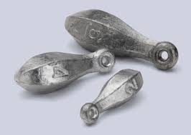
Potential Sources of Exposure
Lead in products used to hunt and fish
Melting lead to make (cast) bullets, sinkers, decoys and other metal items
18
Notes:
Lead products are commonly used for hunting, fishing, and making field equipment.
In some cases, people melt lead to cast their own bullets, sinkers, decoys, and other metal items.
This process emits lead into the air and deposits lead particles into the workspace, and on their clothes, shoes and hair.
Identifying personal uses of lead products is important.
For example, in Cherokee Nation, a child was found to have a confirmed high level of lead in their body (or elevated blood lead level) after making fishing sinkers with their father. Identifying the source of exposure took time.
The environmental staff checked all sources of paint and other potential sources in the home (even though they lived in post-1978 housing) and checked the parents’ work environment. The source was not found until a follow-up search of the garage, where a pile of lead fishing sinkers was discovered. This was determined to be the source of the child’s exposure to lead. In this case, the father, with the help of his children, made his own fishing sinkers using lead.
Lead fishing sinkers are typically made from 100% lead. It only takes a small amount of lead to harm a child; however, there are lead-free tackle options available, which would eliminate this specific source of exposure.

Slide 19
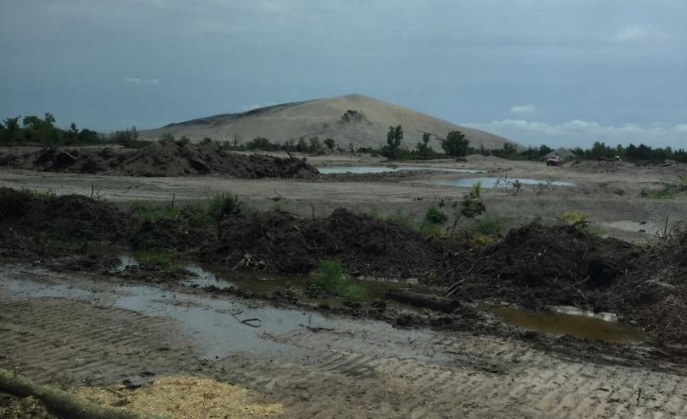
Potential Sources of Exposure
Superfund Sites
  Known to leach lead into soil and groundwater
  Tar Creek Superfund Site
Chat pile
Photo provided by Rick Dubois, Director of Environmental Services at Seneca-Cayuga Nation
19
Notes:
Lead is known to have leached into soil and groundwater at some Superfund sites. Superfund is a program administered by EPA in cooperation with state and tribal governments. It allows EPA to clean up contaminated hazardous waste sites and to compel responsible parties to perform cleanups or reimburse the government for cleanups led by EPA.
One example is the Tar Creek Superfund Site in northeastern Oklahoma, a 40-square-mile former lead and zinc mining area.
The Quapaw Nation, along with state and federal partners, is working hard to clean their land and water to reduce the effects of lead and other pollution that disproportionately affect Quapaw tribal members.
The Quapaw Nation has done a lot since the federal government designated the area as a Superfund Site.
However, due to the destruction and contamination of natural resources, many Quapaw tribal members have ceased or greatly reduced their traditional gathering and use of natural resources to limit exposure.
Water trucks also routinely spray the unpaved roads to minimize dust kicked up by traffic, since most unpaved county roads in the area were graveled with chat, which is crushed limestone, dolomite, and rocks left over from the metal ore separation process.
For more information about Superfund, visit: www.epa.gov/superfund.
Instructor Note: If someone asks that is a chat pile and not a mountain in the background of the photo, which in some cases measured as high as 10 stories and were left when the lead and mining companies ceased operations of these mines in the 1960’s.

Slide 20

Potential Sources of Exposure
Lead can enter soil and water
Lead in soil can:
  Settle on or be absorbed by plants
  Get tracked into the house on the bottom of shoes
  Be inhaled if resuspended in the air
  Use raised garden beds
Notes:
Unfortunately, lead can remain in the environment for many years and enter soil and water. While lead does occur naturally in soil, in many places in the United States, the amount of lead in soil is significantly higher than naturally occurring levels. Some sources of lead contamination in soil include exterior lead-based paint, lead deposited in soil near roadways from vehicle exhaust before lead was banned in gasoline, waste sites, mining, or from other historical lead sources and uses.
Lead in soil can settle on or be absorbed by plants grown for fruits or vegetables, or plants used as ingredients in food, including dietary supplements. Some plants that grow in soils with a high lead concentration can absorb lead from the soil with most of the lead remaining in the roots and, in some rare cases, even making its way to the aboveground parts of the plant.
Lead can also be found on the outside surface of plants, either by sticking to the roots or by settling on the leaves and stems when lead dust is spread through the air.
Lead ingested by animals or absorbed by or found on the surface of plants can then be passed along the food chain when they are consumed by both wildlife and humans.
For example, lead in soil can be ingested due to hand-to-mouth activity that is common for young children and from eating vegetables that may have taken up lead from soil in the garden or field.
Lead in soil may also be inhaled if resuspended in the air or tracked into a house on the bottom of shoes.
Building raised beds and growing plants in containers is the most common way to reduce the chances of coming into contact with contaminants in urban gardens, like in the image you see here. These gardening techniques are preferred because the clean soil and organic matter used to build the raised beds creates a physical barrier between the gardeners/plants and possible contamination in the ground soils. Raised beds can be built for permanent or seasonal use.

Slide 21
Are there other sources of lead exposure in your community?
21
Notes:
I know that was a lot of information and a lot of potential sources and may seem overwhelming, just remember there are many actions we can take to reduce our potential exposure to lead.
Other than the sources mentioned, can you think of sources of lead exposure in your community?

Slide 22
Fill in the Blanks
Lead has been found in a variety of products found in our homes, including: imported scented ___________, toys, glassware, ceramicware and cosmetics.
____________ paint, if present in older homes built before 1978, may be a major source of exposure to lead to those who live there.
The most common sources of lead in ________ water are from lead pipes, faucets and fixtures.
CANDLES
LEAD-BASED
DRINKING
22
Notes:
Let’s take a moment to do a quick review of what we just learned about potential sources of lead exposure.
There are three fill in the blank questions here on the screen. Take a moment to think about the answers and then raise your hand when you think you know all three.
Give them time to answer. Make a comment or two about the responses before reading. Thank them for participating.
Lead has also been found in a variety of products that are found in our homes, including: imported scented ______, toys, glassware, ceramicware and cosmetics. (CANDLES/VELAS)
_____ paint, if present in older homes built before 1978, may be a major source of exposure to lead to those who live there. (LEAD-BASED/ BASE DE PLOMO)
The most common sources of lead in ____ water are from lead pipes, faucets, and fixtures. (DRINKING-BEBER)
Great job everyone! I’m impressed, y’all really know your stuff!

Slide 23



Vulnerable Populations
  Children
  under age 6
  Adults
  through jobs, hobbies or cultural practices
  Pregnant and nursing people
23
Notes:
All humans can potentially be exposed to lead; however, certain groups are more vulnerable than others, including young children under the age of six, pregnant people, and adults who are exposed to lead through their jobs, hobbies, or cultural practices.
I’ll go into a little more detail on how each of these vulnerable populations may be exposed to and affected by lead.

Slide 24

Vulnerable Populations
  Children
  under age 6
24
Notes:
The first is children. Lead is especially dangerous to children under the age of six because their growing bodies absorb more lead than adults, and their developing brains and nervous systems are more sensitive to lead’s damaging effects. Babies and young children’s exposure can be higher because they often put their hands and other objects into their mouths. For example, they may suck on a pacifier dropped on a floor covered with lead dust or eat paint chips or dirt that contains lead.
Children may also be exposed to lead by eating contaminated food or drinking water. This includes drinking powdered formula made with lead-contaminated water, eating lead dust that has settled on food and food preparation surfaces, eating game meat with lead particles, and eating food or drinking liquids stored or cooked in lead crystal or lead-glazed pottery. Food and liquids stored or served in lead crystal or lead-glazed pottery can become contaminated because lead can leach from these containers into the food or liquid.
Different toys and other products may also contain lead. Older toys and furniture passed down in the family or antique doll furniture or toy jewelry could contain lead-based paint or contain lead in its materials. This could become a problem if children bite or swallow toys that contain lead. If you’re a parent, you can stay up to date on product and toy recalls due to lead contamination by visiting the Consumer Product Safety Commission’s website (paste to chat: https://www.cpsc.gov/)

Slide 25

Vulnerable Populations
  Adults through jobs, hobbies or cultural practices
25
Notes:
Working in certain jobs may increase adults’ potential exposure to lead, such as: renovation or repair of older homes and buildings; painting; construction; refinishing furniture; smelting; mining; auto repair and working at hazardous waste sites. Engaging in hobbies, such as making stained glass or ammunition, shooting at a gun range or using certain folk remedies, may also increase the likelihood of exposure to lead. These activities can cause lead dust or soil to get onto your skin, in your hair and clothing, and this dust can then be transferred to the interior of your car or home, which can create lead exposure for the rest of your family.

Slide 26

Vulnerable Populations
  Pregnant and nursing people
26
Notes:
A pregnant person may be exposed to lead from all the sources I previously mentioned and is of concern because it can result in exposure to her developing fetus. While most common in 1- and 2-year-old children, some pregnant people may also be exposed to lead from the intentional ingestion or mouthing of soil, clay or pottery, which is a behavior known as pica. Some people may also deliberately consume clay, soil, or rocks as part of their cultural practices. Pica can result in serious health effects to both the parent and her fetus if the clay, soil or rocks contain lead.

Slide 27

Impacts and Effects of Lead Exposure
Harmful to human health
Impacts the environment and wildlife
27
Notes:
Next, we will elaborate on these effects on humans and wildlife.
Lead has harmful effects on human health.
Lead exposure in humans can cause negative health impacts, which often occur with no obvious symptoms and frequently go unrecognized.
Lead also impacts the environment and wildlife.

Slide 28

Health Effects: Children
Behavior and learning problems
Lower IQ and hyperactivity
Slowed growth
Hearing problems
Anemia
28
Notes:
There is no known safe level of exposure to lead. Even small amounts of lead in children can result in:
Behavior and learning problems;
Lower IQ and hyperactivity;
Slowed growth;
Hearing problems; and
Anemia, a condition where one has low levels of iron in the blood.
In rare cases, high amounts of lead can have devastating effects, including seizures, coma and in some cases, even death.

Slide 29
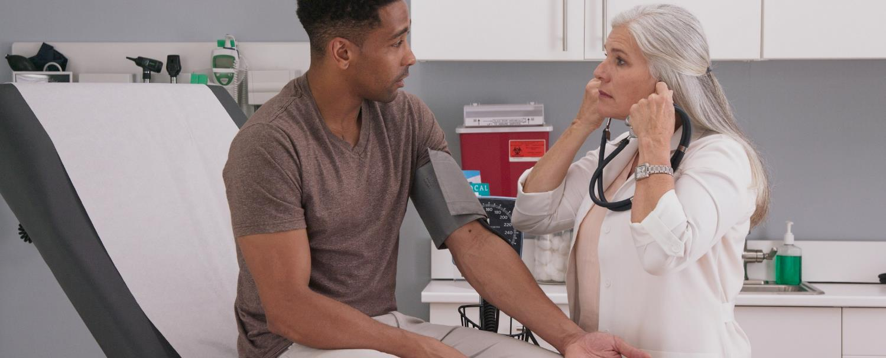
Health Effects: Adults
Increased blood pressure and incidence of hypertension
Decreased kidney function
Reproductive problems (in both men and women)
29
Notes:
Adults exposed to lead can suffer from:
Nerve disorders;
Increased blood pressure;
Decreased kidney function;
Reproductive problems; and
Memory and concentration problems.

Slide 30

Health Effects: Pregnant People
Lead can pass from the parent, exposing the fetus or breastfeeding infant
Puts the parent at risk for miscarriage
Baby may be born too early or too small
Hurts the baby’s brain, kidneys and nervous system
30
Notes:
Lead can accumulate in our bodies over time, where it is stored in our bones. During pregnancy, lead is released from the parent’s bones along with calcium and exposes the fetus or breastfeeding infant to lead. This occurs especially when the parent does not receive adequate dietary calcium, and can result in serious effects including:
Causing the baby to be born too early or too small;
Putting the parent at risk for miscarriage.
Hurting the baby’s brain, kidneys or nervous system; and
Increasing the likelihood of learning or behavioral problems.

Slide 31

Health Effects: Wildlife
Lead can also impact wildlife species, such as birds, mammals and amphibians
Animals can be exposed to lead from mining, facility emissions and lead-based paint
Major source of exposure is ingestion of lead fishing tackle and spent lead ammunition
31
Notes:
Like humans, ingestion of lead in the food web can also impact wildlife species, such as birds, mammals and amphibians.
Upon ingestion of significant amounts of lead, birds may show behavioral changes, such as: unsteady legs, droopy wings, accidents when trying to land, and in more severe cases, blindness and the inability to hold up their head. Lead exposure to mammals can result in vomiting, loss of appetite, diarrhea, lethargy and uncoordinated body movements. In amphibians, such as toads and frogs, exposure to lead can result in an increase in skin shedding, sluggishness and decreased muscle tone.
Animals can be exposed to lead from mining, facility emissions and lead-based paint. However, research indicates that ingesting lead fishing tackle and spent lead ammunition are two of the major sources of lead exposure in wildlife.
Optional information to add:
Secondary lead poisoning can occur when predators and scavengers target wounded prey that has been shot or eat animal parts that contain lead fragments from spent ammunition. This source particularly impacts scavenging bird species such as hawks, eagles, vultures, condors, ravens, magpies, jays, etc. Lead poisoning affects their muscles, nerves, kidney function, reproductive systems, and flight capacity and can result in paralysis and starvation.
Waterfowl species, such as loons, ducks, geese and swans, are also commonly affected by lead through the ingestion of spent lead shot and used sinkers or tackle. However, many other types of birds can also be affected. Upon ingestion of significant amounts of lead, birds may show behavioral changes, such as: unsteady legs, droopy wings, accidents when trying to land, and in more severe cases, blindness and the inability to hold up their head.
Other symptoms include listlessness, vomiting, diarrhea and impaired flight.
Lead poisoning can also occur in mammals, such as raccoons, bears, wolves and foxes. Lead exposure to these mammals can result in vomiting, loss of appetite, diarrhea, lethargy and uncoordinated body movements. Repeated exposures over time can result in anemia, convulsions, blindness, coma or death.
In amphibians, such as toads and frogs, exposure to lead can result in an increase in skin shedding, sluggishness and decreased muscle tone.

Slide 32

Non-Lead Alternatives for Fishing and Hunting Activities
Action is being taken to increase use of non-lead alternatives for fishing and hunting activities
For fishing and hunting activities, use:
  Non-lead ammunition
  Non-lead lures or sinkers
32
Notes:
Given rising concerns over known and potential impacts of lead on wildlife, many tribes and states are taking action to increase the use of non-lead alternatives for fishing and hunting activities within their boundaries. In fact, many tribes and states have their own regulations and programs concerning the use of lead-free ammunition and tackle. This is in addition to the U.S. Fish and Wildlife Service ban in 1991 of the use of lead shot nationwide for hunting waterfowl.
One example of this is the Nez Perce Tribe of north-central Idaho who initiated regional dialogue on this topic and has established a Hunter Stewardship and Safety Program centered on lead-free subsistence hunting. The program offers an ammunition exchange option and facilitates community outreach to share awareness about the human health and wildlife conservation benefits of choosing to switch to copper-based ammunition when harvesting food. An example of a state program is the Minnesota Pollution Control Agency’s Get the Lead out program, which is an educational program to protect and restore the population of common loons in Minnesota by reducing their exposure to lead-based fishing tackle.

Slide 33
Are you aware of specific stories of how lead has already impacted your community?
33
Notes:
Lead, like other heavy metals, has the potential to impact cultural practices. Are you aware of specific stories of how lead has already impacted your community?

Slide 34

Cultural Impacts
Using natural resources
Imported materials
    Spices
34
Notes:
I have a couple examples that were shared with us previously of lead’s impacts on cultural practices:
Be cautious of imported spices. Lead has been found in certain spices imported from Vietnam, India, and Syria among other countries. Lead has also been found in powders and tablets given for arthritis, infertility, upset stomach, menstrual cramps, colic, and other illnesses traditionally used by East Indian, Indian, Middle Eastern, West Asian, and Hispanic cultures.
Using natural resources– Natural resources, such as soil, clay, wood and plants are commonly used for various items. However, it is important to know where these items come from and whether the natural resources being used are contaminated with lead before using them and to consider other options when possible.
Using imported materials – There is a story that has been shared with us from a community in Colorado that has a high population of African immigrants. Many of these immigrants have continued the practice of using a colored paste that they put under the eyes to enhance intelligence. A child in that community was found to have an EBLL and after doing an investigation the exposure source ended up being from the paste, which was being shipped from Africa and the paste’s coloring came from a lead-based additive. It was recommended that the parents stop this practice and when they did EBLL went down quickly.
Hunting deer, moose, elk and game – Most hunting ammunition is lead-based, which means both wildlife and humans are at risk of lead exposure from the consumption of spent ammunition in game meat and internal organs of an animal used as food (Refs. 23 & 24). In a recent study completed in North Dakota, participants who ate any wild game had higher blood lead levels than participants who did not consume wild game (Ref. 25). Lead exposure cannot be eliminated by cutting out the bullet wound channel and trimming meat at the site of impact. The typical lead-core bullet loses 30-40% of its weight in big game animal carcasses; hundreds of fragments are dispersed when a lead bullet is fired into an animal, making it impossible to remove all fragments. Using lead-free ammunition is the best way to avoid this risk of exposure.
Gathering traditional and cultural foods – Many traditional and cultural foods are gathered in natural areas that may be contaminated with lead (or other harmful materials); thus it is important to wash items thoroughly with clean water sources prior to eating. For example, to reduce the risk of exposure to lead, one southwest tribe makes sure its members thoroughly wash watercress and wild onions grown in the early spring to remove any contaminated soil from the plant’s surface. Another northwest tribe, living in an area with known lead soil contamination, recommends washing and then removing the skins of water potatoes prior to cooking and eating to reduce exposure. Overall, it is a good practice to thoroughly wash gathered foods prior to cooking and eating as well as to understand whether possible exposure scenarios exist in your community.
Burning materials and ingredients for cultural and medicinal activities - Many tribal activities involve burning different materials for traditional, cultural and medicinal practices. In some cases, ashes and smoke have been found to be contaminated with chemicals, such as when unknowingly burning wood coated with lead-based paint. It is important to know the source of the materials being burned to prevent community members from being exposed to lead through both ingestion and breathing.
Using natural life sources for various items – Natural resources are commonly used to create cultural items, such as clay and soil for makeup and paints. However, it is important to know whether natural resources being used are contaminated with lead before using them. Consider other options if possible. Hire a professional or contact a lab to test for the presence of lead in natural resources.
Returned museum artifacts – Museum artifacts were often preserved using mercury, arsenic, lead and other toxic chemicals. Although chemists are working on ways to clean them well enough for reuse, it is important to understand that some older items may contain lead or other harmful chemicals and thus increase potential exposure to lead. When these artifacts are returned, be sure to ask questions about the prior preservation processes used.

Slide 35
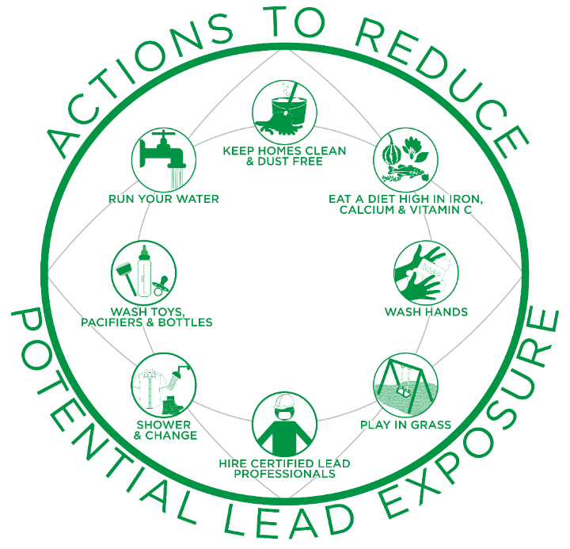
Taking Action
Lead exposure and lead poisoning is preventable!
35
Notes:
V. Taking Action
Lead exposure and lead poisoning is preventable!
In fact, many organizations, groups, tribes and states have implemented their own programs and projects over the years to lower their exposure to lead and its harmful effects.
Now we are going to continue our discussion of actions you can take at home to reduce your family’s potential exposure to lead.

Slide 36
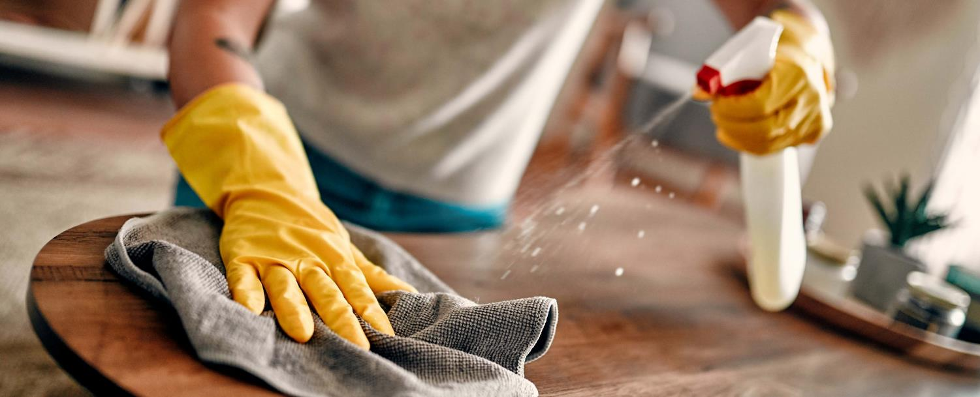
Keep Homes Clean & Dust-Free
Wet mop floors and hard surfaces
Wipe down hard surfaces with a wet cloth
Inspect and maintain painted surfaces
Wet wipe peeling, chipping, chalking or cracking paint
36
Notes:
Keep Homes Clean & Dust-Free
Wet mop floors and hard surfaces (e.g., porches) to minimize lead dust.
Wipe down hard surfaces such as countertops, window sills and doors jambs with a wet cloth.
Inspect and maintain all painted surfaces to guard against deterioration.
Wet wipe the area immediately if you notice any peeling, chipping, chalking or cracking paint. – It is important that you do not pick at or scrape the area and also remove a child’s access to the area.

Slide 37

Eat a Diet High in Iron, Calcium & Vitamin C
Wash food thoroughly with clean water prior to eating
Do not eat food or drink water that has been cooked or stored in chipped or cracked lead-crystal, lead-glazed pottery or lead-porcelain cookware
37
Notes:
b. Eat a Diet High in Iron, Calcium & Vitamin C
Ensure family members eat a well-balanced diet of fruits, vegetables, grains, dairy and protein foods. Foods that are higher in calcium, iron and vitamin C can help reduce the absorption of lead. Children with healthy diets absorb less lead.
Wash all food, including traditional and cultural foods gathered in natural areas, thoroughly with safe water sources prior to eating. This helps to remove soil or lead dust that may have adhered to the surface of the food.
Do not eat food or drink water cooked or stored in chipped or cracked lead-crystal, lead-glazed pottery or lead-porcelain cookware.

Slide 38

Eat a Diet High in Iron, Calcium & Vitamin C
Use only cold water for drinking, cooking and preparing baby formula
Know the source of natural resources, ingredients, herbs, etc.
Check governmental fish advisories for recommendations on fish consumption
38
Notes:
Use only cold water for drinking, cooking and preparing baby formula. Use water from a safe source to mix baby formula.
Know the sources of natural resources, ingredients, herbs, etc. being used for various purposes to prevent exposure to lead through ingestion or breathing.
Check local, tribal and regional fish advisories for recommendations on fish consumption for pregnant people, children under 15 years of age and the general public. This includes recommendations on numbers to be consumed per month for specific fish and whether it is recommended to eat only the fillet or the whole fish.

Slide 39
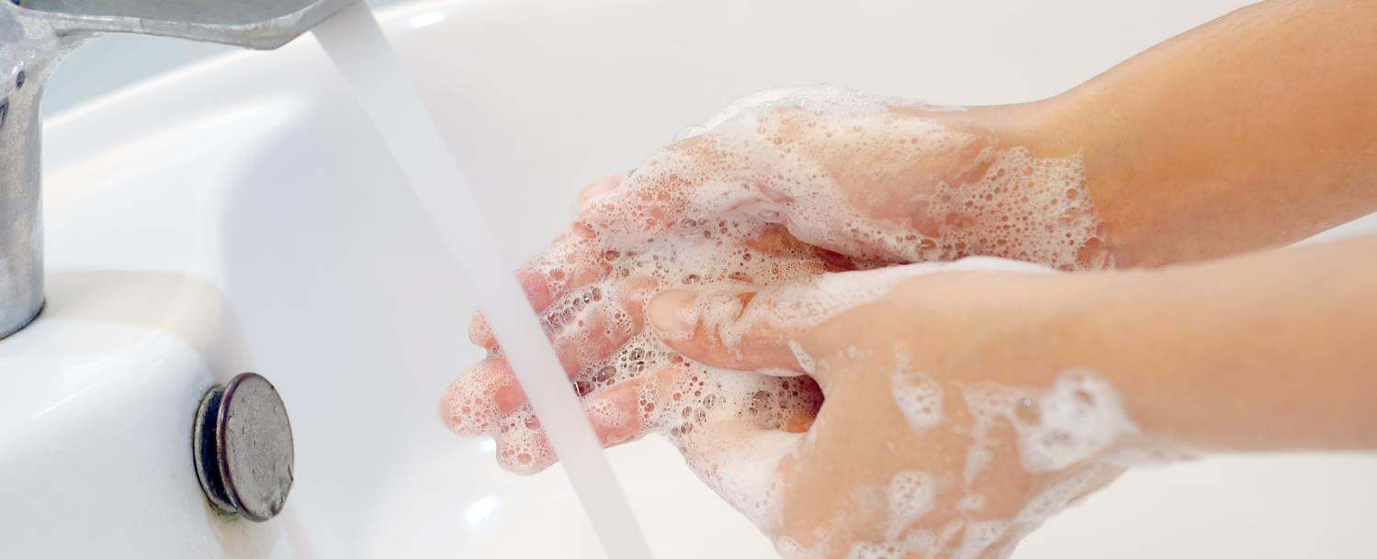
Wash Hands
Use soap and water (warm or cold) to wash children’s hands several times a day
Adults should wash their hands after participating in activities in which they may have come in contact with lead
39
Notes:
c. Wash Hands
Use soap and water (warm or cold) to wash children’s hands several times a day, especially after playing outside or with animals.
Adults should wash hands after participating in activities where they may have come in contact with lead.

Slide 40

Play in Grass
Play in grassy/non-contaminated bare soil areas
Use designated picnic, camping and hiking areas
Wipe, remove shoes and wash hands after playing outdoors
Wipe off pet’s paws
Place dust mats inside and outside your home
40
Notes:
d. Play in Grass
Guide children to play in grassy or non-contaminated bare soil areas, especially if play areas are near roadways, junk yards, older buildings and uncontrolled or abandoned sites or properties.
Use designated picnic, camping and hiking areas.
Teach children to wipe and remove their shoes and to wash their hands after playing outdoors.
Wipe off pets’ paws prior to bringing them indoors.
Place dust mats both inside and outside your home.

Slide 41

Hire Certified Lead Professionals
Hire a certified lead professional for renovation and repair work on pre-1978 homes
Make sure your contractor is Lead-Safe Certified by EPA
www.epa.gov/lead/findacontractor
41
Notes:
e. Hire Certified Lead Professionals
For homes built prior to 1978, hire a certified lead professional for renovation and repair work. Keep residents out of the work area during renovation or repair work which disturbs painted surfaces until the work area is cleaned.
When having home renovations, repairs or painting done, make sure your contractor is Lead-Safe Certified and follows lead-safe work practices per the requirements of EPA’s Renovation, Repair and Painting Rule. These professionals have special training and are certified to perform this type of work.
If you are renting your home or apartment and think it may contain lead-based paint or lead hazards, make sure your landlord or housing authority hires a Lead-Safe Certified contractor to do renovation, repair and painting work.
EPA has a site where you can find a lead-safe certified professional by state: www.epa.gov/lead/findacontractor
Consider hiring a certified lead professional to conduct a lead-based paint inspection of any 1978 homes to find out if your home has lead-based paint and where it is located.
If you decide to do your own renovation, repair and painting work yourself, make sure to use lead-safe work practices for do-it-yourself (DIY) home renovation projects to protect you and your family. You can find more information about the DIY lead-safe work practices at epa.gov/lead/rrp-diyers.

Slide 42

Shower & Change
Clean or remove work clothes and shoes before entering your home
Wash work clothes separately
Shower after activities in which you may have been exposed to lead
42
Notes:
f. Shower & Change
Clean or remove work clothes and shoes before entering your home to avoid tracking in lead from soil, work sites or hobbies. Store work clothes and shoes in a designated area outside the home.
Wash work clothes separately from other family members’ clothes.
Shower after participating in activities where you may have been exposed to lead to remove any lead dust from your skin and hair.

Slide 43
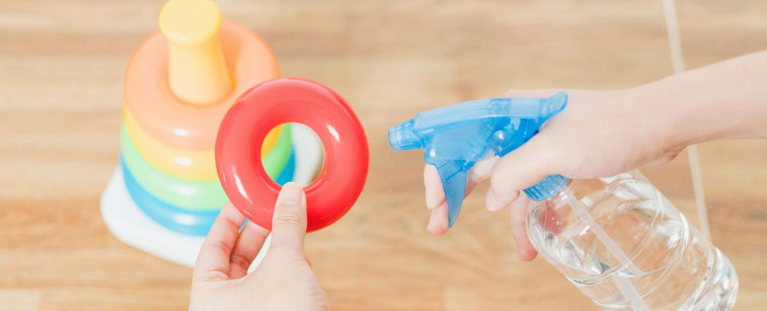
Wash Toys, Pacifiers & Bottles
Wash children’s pacifiers, bottles, and toys, like stuffed animals, often
Do not let children chew on painted toys, window sills or other painted surfaces
43
Notes:
g. Wash Toys, Pacifiers & Bottles
Wash children’s pacifiers, bottles, and toys, like stuffed animals, often.
Do not let children chew on painted toys, window sills or other painted surfaces.

Slide 44
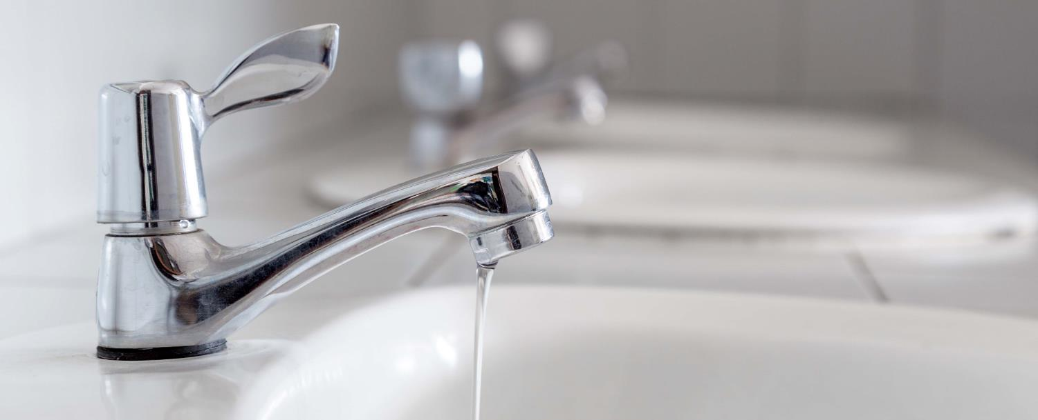
Run Your Water
Before drinking, flush your home’s pipes by running the tap, taking a shower, doing laundry or washing dishes
Use a water filter that is certified to remove lead
Clean faucet screens regularly
44
Notes:
h. Run Your Water
Before drinking, flush your home’s pipes by running the tap, taking a shower, doing laundry or doing a load of dishes. The amount of time to run the water will depend on whether your home has a lead service line or not, and the length of the lead service line. Residents should contact their water utility for recommendations about flushing times in their community.
Use only cold water for drinking, cooking and making baby formula. Remember, boiling water does not remove lead from water. Heat up cold water on the stove or in a microwave if hot or warm water is needed.
Use a filter certified to remove lead. Read the directions to learn how to properly install and use your cartridge and when to replace it. Using the cartridge after it has expired can make it less effective at removing lead. Do not run hot water through the filter.
Clean your faucet’s screen (also known as an aerator) regularly. Sediment, debris, and lead particles can collect in your aerator. If lead particles are caught in the aerator, lead can get into your water.

Slide 45

Run Your Water
Contact your water utility or a licensed plumber to:
  Determine if the pipe that connects your home to the water main (service line) is made from lead
  Test your water for lead
  Learn about lead levels in your drinking water
45
Notes:
Contact your water utility or a licensed plumber to determine if the pipe that connects your home to the water main (called a service line) is made from lead.
Contact your water utility to have your water tested and to learn more about the lead levels in your drinking water.

Slide 46
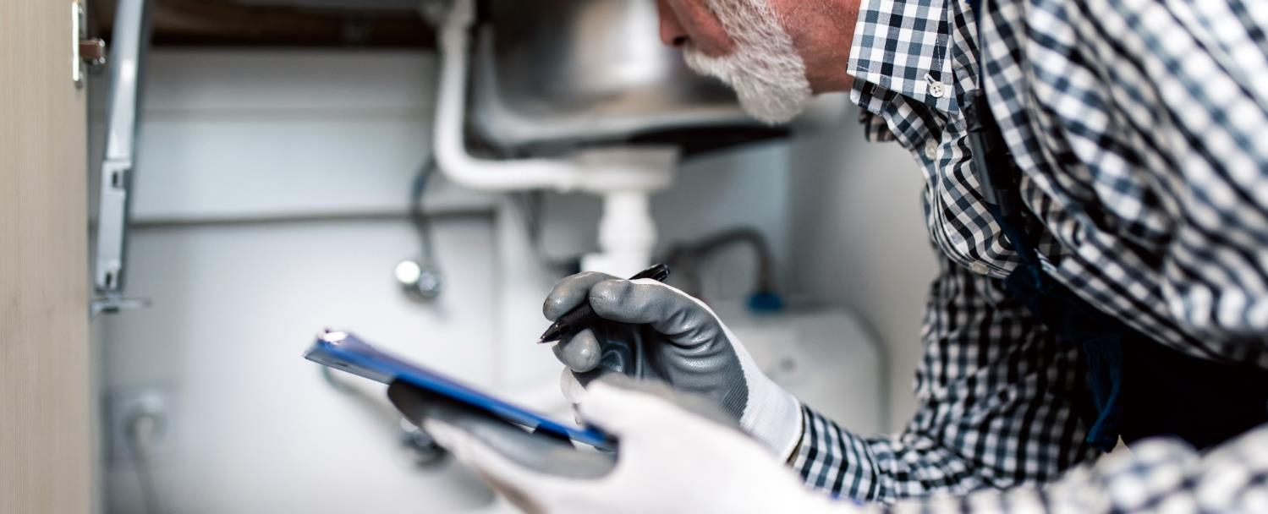
Run Your Water
If your drinking water comes from a private well or cistern, check with your health department or nearby water utility for information on water in your area
Be aware of any construction or maintenance work that could disturb your lead service line
46
Notes:
Check with your health department or nearby water utilities that use ground water for information on the water in your area, if your drinking water comes from a private well (or cistern).
Be aware of any construction or maintenance work that could disturb your lead service line. Construction may cause more lead to be released from a lead service line.

Slide 47
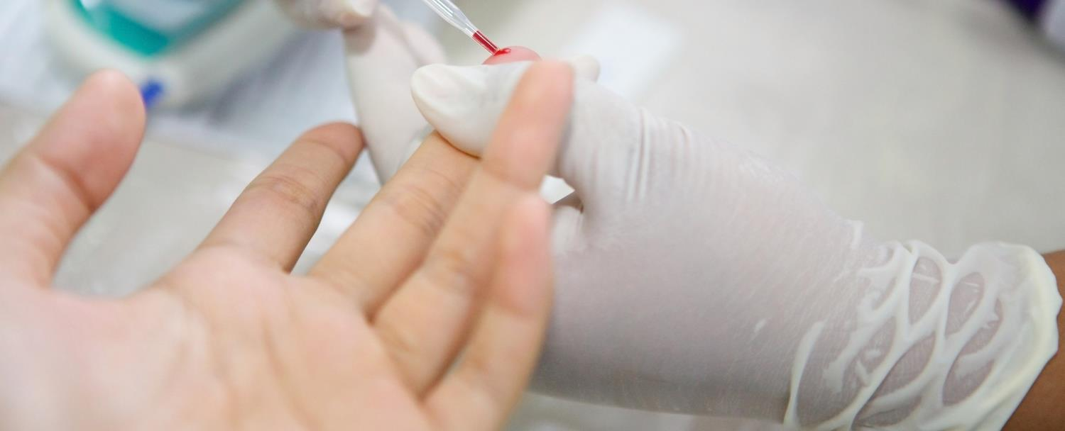
Getting Your Child Tested
Lead exposure often occurs with no obvious symptoms
A blood test is the only way to know if a child has lead in their blood
Testing is generally recommended at ages 1 and 2
47
Notes:
The only way to know if a child has lead in their blood is to have a blood test.
Because lead exposure often occurs with no obvious symptoms, it frequently goes unrecognized.
No amount of lead is safe for children. It is generally recommended that children be tested at ages one and two.

Slide 48
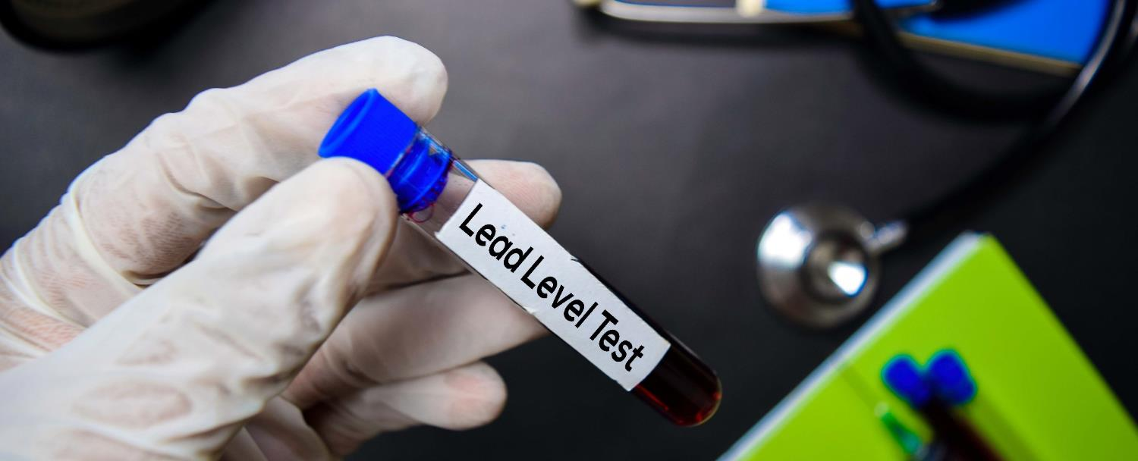
Getting Your Child Tested
Contact your healthcare provider, local health department, clinic or hospital
[Community Health Center]
  Address
  Phone
  Hours of operation
48
Notes:
Raise your hand if your children or grandchildren have been tested for lead in the past. Contact your healthcare provider, local health department, clinic or hospital if you would like more information about testing your children or family members for lead. If lead is detected, your healthcare professional will make recommendations on next steps.
If you don’t have a health care provider, you can visit [insert community-specific information].

Slide 49

Before You Buy or Rent
Before signing a lease or contract, homebuyers and renters have the right to know whether lead is present.
49
Notes:
Before we end today’s session, I want to share important information about the right of homebuyers and renters to know if lead is present before signing a lease or contract.
Federal law requires that anyone selling or renting pre-1978 housing provide specific information about lead-based paint and/or lead-based paint hazards before a contract or lease is signed. However, this is not required if the housing is:
For the elderly or persons with disabilities (unless a child under the age of 6 lives or is expected to live in such housing);
A zero-bedroom dwelling; or
If painted surfaces* have been declared lead-free.
*Instructor Note: If asked what is meant by painted surfaces in #3 that includes doors, windows, walls, any outbuildings, fences, signs, etc.

Slide 50

Federal Law Requires Buyers & Renters Receive
  A copy of the Protect Your Family From Lead in Your Home pamphlet
  Any information about the presence of lead-based paint and/or lead-based paint hazards
  Disclosure of information in or attached to the contract/lease
  Submit complaints to EPA at 1-800-424-5323
Notes:
Before signing a contract or lease for a pre-1978 home federal law requires that buyers and renters receive all of the following:
A copy of EPA’s Protect Your Family From Lead in Your Home pamphlet, which is available in multiple languages and shown here
Any known information about the presence of lead-based paint and/or lead-based paint hazards in the home or building
For multi-unit buildings, this includes report and records for common areas and other units from building-wide evaluations
A disclosure of information that is either attached to or included in the contract/lease that includes a “Lead Warning Statement” and confirms the seller or landlord have complied with all notification requirements
Buyers also have 10 days to conduct a lead-based paint inspection or risk assessment
If you are not provided this information, ask for it. You can also submit a complaint to EPA by calling the National Lead Information Center at 1-800-424-LEAD [5323].
Instructor note: The “Protect Your Family” pamphlet is available in 12 different languages, both in color and black and white and can be provided to buyers and renters either in print or digitally.

Slide 51

Conclusion
We discussed:
  Potential sources of lead exposure
  How lead harms children and adults
  Lead’s impacts on the environment and wildlife
  Actions that can be taken to prevent potential lead exposure
49
Notes:
VI. Conclusion
Today we discussed sources of lead exposure; how lead harms children and adults; its impacts on the environment and wildlife; and actions that you can take to prevent potential exposure to lead.

Slide 52
Review
What are the potential health effects of children exposed to lead?
Behavior and learning problems;
Lower IQ and hyperactivity;
Slowed growth;
Hearing problems; and
Anemia.
Are wildlife species also vulnerable to lead exposure and lead poisoning effects?
Yes!
50
Notes:
To review, I have a couple questions for the group:
1. What are the potential health effects of children exposed to lead? Take a moment to think and then please type at least one potential health effect in the chat box.
Even small amounts of lead in the blood of children can result in:
Behavior and learning problems;
Lower IQ and hyperactivity;
Slowed growth;
Hearing problems; and
Anemia.
In rare cases, high amounts of lead can have devastating effects on children, including seizures, coma and in some cases, even death.
2. Are wildlife species also vulnerable to lead exposure and lead poisoning effects? If think the answer is yes, raise your hand.

Slide 53
Does anyone have any questions about the information covered today?
51
Notes:
Today was meant to be an introduction to the topics and the other modules in the Curriculum go into more detail about how to effectively clean your home to reduce exposure; good hygiene practices for both kids and adults, including nutritional information and how and when to hire a certified lead professional to remove lead from the home.
Does anyone have any questions about the information covered today?
Raise your hand or shout it out!

Slide 54
National Lead Information Center
1 (800) 424-LEAD [5323]
Ask for information about lead, lead hazards and lead exposure prevention.
Monday to Friday, 8:00 am to 6:00 pm ET (except federal holidays).
Hearing- or speech-challenged individuals may access this number through TTY by calling the Federal Relay Service at 1-800-877-8339.
52
Notes:
If you have any questions after the session today or want more information about lead, you can contact the National Lead Information Center (or NLIC) using this toll free number.
The NLIC provides the public and professionals with information about lead, lead hazards and lead exposure prevention. You can also call NLIC to file a complaint about your landlord or a contractor if they are not following the federal laws about lead mentioned earlier. Call to speak with a specialist Monday through Friday, 8:00 am to 6:00 pm Eastern time (except federal holidays) at 1 (800) 424-LEAD [5323]. Hearing- or speech-challenged individuals may access this number through TTY by calling the Federal Relay Service at 1-800-877-8339.
Instructor Note: Participants can find this number on both the worksheet and key messages.

