Slide 1
Community Name
Month, Day, Year
Notes:
Good morning and welcome to today’s Understanding Lead Session. My name is [Name] and I [you can insert your job title here] and I will be one of your speakers today.
I would like to start by thank all of you for joining us to learn about lead, its impact’s and how to reduce and prevent lead exposure and protect communities, with a focus on children, who are most vulnerable.

Slide 2

Outline
Potential Sources of Lead Exposure
Vulnerable Populations
Impacts and Effects of Lead Exposure
Taking Action
2
Notes:
You may have heard of lead or lead poisoning before today but may not know much about it. Our goal today is for you to walk away with an understanding of
What lead is and where it is found;
How lead can harm children, adults, and wildlife; and
How you can take action to reduce and prevent exposure to lead

Slide 3
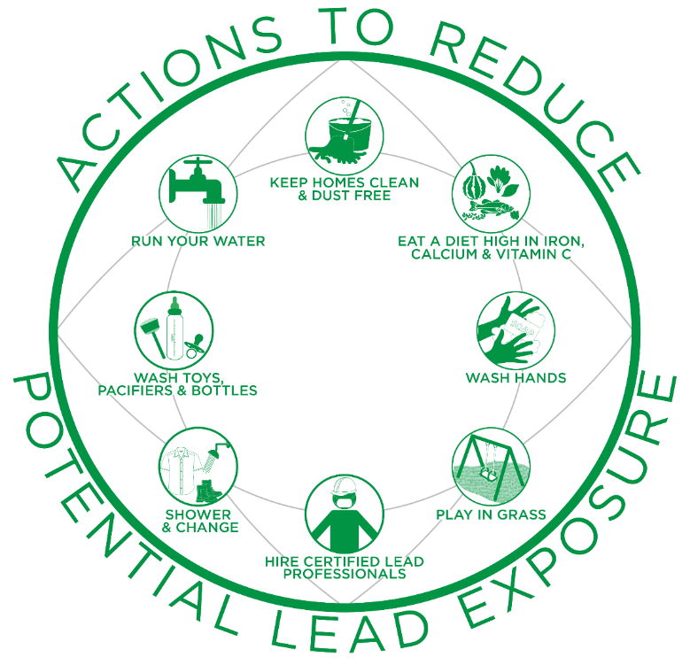
3
Notes:
Instructor Note: If you haven´t already, pass out the worksheet to all participants so they can reference it during the presentation.
I would like to acknowledge that the information we are covering today may seem alarming, however exposure to lead is preventable!
With that in mind I wanted to start today by showing the Actions to Reduce Potential Lead Exposure Infographic [which can be found on the front of your worksheet] to emphasize there are many simple actions we can take to prevent lead exposure. We will be going over the 8 actions on the infographic, and more, in detail in the second part of today’s presentation.

Slide 4
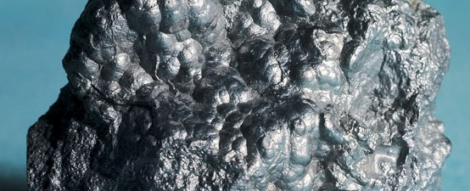
What is Lead?
http://mfritz8science.wikispaces.com/file/view/lead_1.jpg/262242078/lead_1.jpg
Bluish-gray metal found in small amounts in the earth’s crust.
Impossible to identify with the naked eye.
Does not biodegrade or disappear from the environment over time.
4
Notes:
What is Lead?
Lead is a naturally occurring bluish-gray metal found in small amounts in the earth’s crust.
While it has some beneficial uses, it can be toxic to humans and animals, causing lifelong health impacts. Once lead is used in a product, it is nearly impossible to identify with the naked eye.
Lead does not biodegrade or disappear from the environment over time.
Congress has passed laws that limit the amount of lead that can be in products, outdoor air, emissions from some industrial sources, waste waters and more.

Slide 5
Where do you think lead can be found?
5
Notes:
Where do you think lead can be found? Take a moment to glance around the space you are in and think about your everyday activities. Pencils may come to mind, but they are made with graphite and not lead.
Proposal: 2-3 minutes of engagement
Instructor Note: Give participants time to think. If they are unable to think of something, you can either prompt them by suggesting items or simply state: “Don’t worry if you cannot think of something. Today we will learn where lead is found and how to prevent exposure.”

Slide 6
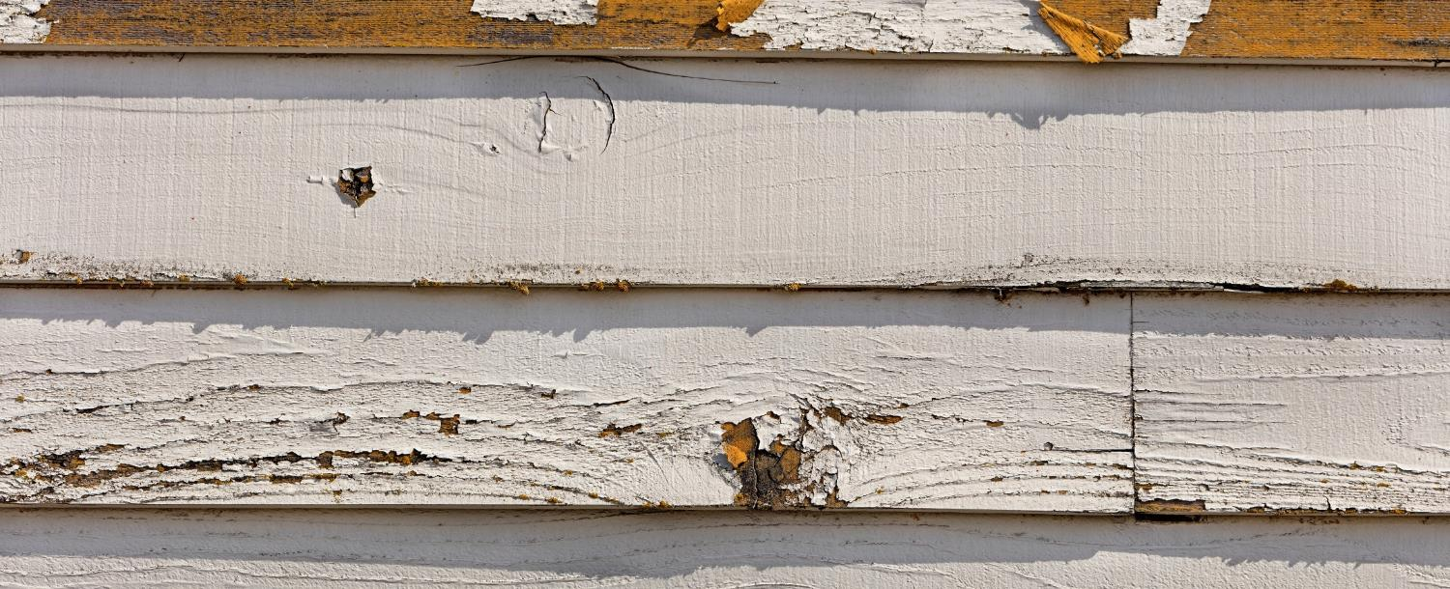
Lead-based Paint
Found in older homes built before 1978.
Major source of exposure when not maintained.
  i.e., peeling, chipping, cracking
Chips and dust can scatter and become a hazard, which can be breathed in or swallowed by children, residents and workers.
Renovation, repair, or remodeling projects in a pre-1978 home can easily create dangerous lead dust.
6
Notes:
Historically, lead compounds were added to paints to enhance color, reduce corrosion, or shorten drying time.
Lead-based paint, if present in older homes built before 1978, may be a major source of exposure to lead to those who live there. When painted surfaces are not properly maintained, paint can deteriorate, peel, chip, chalk, or crack. When lead-based paint is old and worn or is subject to constant rubbing (as on doors and windowsills), lead-based paint chips and dust can scatter and become a hazard. These hazards can be breathed in or swallowed by children, residents, and workers. Any renovation, repair, or painting (RRP) project in a pre-1978 home that disturbs painted surfaces can easily create dangerous lead dust, which can harm children and adults.
When lead-based paint is in good condition and is not on an impact or friction surface, like a window, the paint is usually not a hazard.

Slide 7



Potential Sources of Exposure
Painted farm equipment and boats
Imported pottery, candles, older mini blinds
Toys
Ceramicware
Solder
Batteries
Ammunition
Fishing tackle
Old cellphones in disrepair
Cosmetics
Photo by Randy Fath on Unsplash
Imported pottery from Mexico
Toy Recall from https://www.cpsc.gov/Recalls/2007/rc2-corp-recalls-various-thomas-friends-wooden-railway-toys-due-to-lead-poisoning
7
Notes:
Lead and lead compounds have been used in a wide variety of products found in and around our homes, including paint used on some farm equipment and boats; imported pottery, scented candles and older mini blinds; glassware; toys; ceramicware; solder; batteries; ammunition; fishing tackle; old cell phones that are in disrepair, and cosmetics (e.g., lipstick).
Instructor Note: If participants asks about recalls, can provide the following resource: If you’re a parent, you can stay up to date on product and toy recalls due to lead contamination by visiting the Consumer Product Safety Commission’s website (paste to chat: https://www.cpsc.gov/)

Slide 8


Potential Sources of Exposure
Lead can enter drinking water when plumbing materials that contain lead corrode.
  Lead pipes
  Faucets
8
Notes:
Lead can enter drinking water when plumbing materials that contain lead corrode.
The most common sources of lead in drinking water are from lead pipes, faucets and fixtures.
Lead pipes are more likely to be found in older cities and homes built before 1986.
Instructor note:
If someone asks about showering/drinking from lead pipes/faucets:
It is safe to take a bath or shower using water suspected of containing lead. The answer is yes. Bathing and showering should be safe for you and your children, even if the water contains lead. Human skin does not absorb the lead in water.

Slide 9

Potential Sources of Exposure
Lead can enter soil
Lead in soil can:
  Settle on or be absorbed by plants
  Get tracked into the house on the bottom of shoes
  Be inhaled if resuspended in the air
  Use raised garden beds
9
Notes:
Unfortunately, lead can also enter the soil and can then be ingested due to young children’s normal hand-to-mouth activity and from eating vegetables that may have taken up lead from soil in the garden or field. Lead can also be ingested by animals if they eat plants grown in lead-contaminated soil.
Lead in soil may also be inhaled if resuspended in the air or tracked into a house on the bottom of our shoes.
Building raised beds and growing plants in containers is the most common way to reduce the chances of coming into contact with contaminants in urban gardens, like in the image you see here. These gardening techniques are preferred because the clean soil and organic matter used to build the raised beds creates a physical barrier between the gardeners/plants and possible contamination in the ground soils. Raised beds can be built for permanent or seasonal use.

Slide 10

Potential Sources of Exposure
Imported materials
  Spices
  Pottery
Ammunition and fishing tackle
10
Notes:
There can be a greater risk of lead exposure when using products imported from countries without laws in place that regulate the use of lead.
Some products that have been found to contain lead, especially when imported from other countries, include:
Spices.
Traditional and folk remedies given for arthritis, infertility, upset stomach, menstrual cramps, colic, and other illnesses.
Pottery. Some traditional pottery made in other countries may contain lead in the glazes and/or decorations covering the surface. If clay pieces are not manufactured properly, lead glaze can leach into food and drinks that are prepared, stored, or served in these dishes.
Ammunition and fishing tackle used for hunting and fishing activities can contain lead. Humans are at risk of lead exposure from the consumption of spent ammunition in game meat. Wildlife are also at risk of lead exposure from spent ammunition in wounded prey or discarded animal parts and from ingesting lead fishing tackle [when they eat fish with ingested or attached tackle or scoop up sinkers from the bottom of lakes]. Using lead-free ammunition and fishing tackle is the best way to avoid this risk of exposure.
Optional stories to replace/include:
Be cautious of using imported materials. – There is a story that has been shared with us from a community in Colorado that has a high population of African immigrants. Many of these immigrants have continued the practice of using a colored paste that they put under the eyes to enhance intelligence. A child in that community was found to have an EBLL and after doing an investigation the exposure source ended up being from the paste, which was being shipped from Africa and the paste’s coloring came from a lead-based additive. It was recommended that the parents stop this practice and when they did EBLL went down quickly.
Use lead-free ammunition for hunting or fishing activities. – Most hunting ammunition is lead-based, which means both wildlife and humans are at risk of lead exposure from the consumption of spent ammunition in game meat and internal organs of an animal used as food. In a recent study completed in North Dakota, participants who ate any wild game had higher blood lead levels than participants who did not consume wild game (Ref. 25). Lead exposure cannot be eliminated by cutting out the bullet wound channel and trimming meat at the site of impact. The typical lead-core bullet loses 30-40% of its weight in big game animal carcasses; hundreds of fragments are dispersed when a lead bullet is fired into an animal, making it impossible to remove all fragments. Using lead-free ammunition is the best way to avoid this risk of exposure.
Using natural resources– Natural resources, such as soil, clay, wood and plants are commonly used for various items. However, it is important to know where these items come from and whether the natural resources being used are contaminated with lead before using them and to consider other options when possible.
Gathering traditional and cultural foods – Many traditional and cultural foods are gathered in natural areas that may be contaminated with lead (or other harmful materials); thus it is important to wash items thoroughly with clean water sources prior to eating. For example, to reduce the risk of exposure to lead, one southwest tribe makes sure its members thoroughly wash watercress and wild onions grown in the early spring to remove any contaminated soil from the plant’s surface. Another northwest tribe, living in an area with known lead soil contamination, recommends washing and then removing the skins of water potatoes prior to cooking and eating to reduce exposure. Overall, it is a good practice to thoroughly wash gathered foods prior to cooking and eating as well as to understand whether possible exposure scenarios exist in your community.
Burning materials and ingredients for cultural and medicinal activities - Many tribal activities involve burning different materials for traditional, cultural and medicinal practices. In some cases, ashes and smoke have been found to be contaminated with chemicals, such as when unknowingly burning wood coated with lead-based paint. It is important to know the source of the materials being burned to prevent community members from being exposed to lead through both ingestion and breathing.
Using natural life sources for various items – Natural resources are commonly used to create cultural items, such as clay and soil for makeup and paints. However, it is important to know whether natural resources being used are contaminated with lead before using them. Consider other options if possible. Hire a professional or contact a lab to test for the presence of lead in natural resources.
Returned museum artifacts – Museum artifacts were often preserved using mercury, arsenic, lead and other toxic chemicals. Although chemists are working on ways to clean them well enough for reuse, it is important to understand that some older items may contain lead or other harmful chemicals and thus increase potential exposure to lead. When these artifacts are returned, be sure to ask questions about the prior preservation processes used.

Slide 11
Let’s review: What are some sources of exposure to lead?
11
Notes:
Raise your hand or shout it out!
If you want to test yourself later, the back of the worksheet has multiple questions you can use to review what you learned about potential sources of lead exposure.

Slide 12



Vulnerable Populations
  Children
  under age 6
  Adults
  through jobs, hobbies or cultural practices
  Pregnant and nursing people
12
Notes:
All humans can potentially be exposed to lead; however, certain groups are more vulnerable than others, including young children under the age of six, pregnant people, and adults who are exposed to lead through their jobs, hobbies, or cultural practices.
I’ll go into a little more detail on how each of these vulnerable populations may be exposed to and affected by lead.

Slide 13

Vulnerable Populations
  Children under age 6
13
Notes:
The first is children. Lead is especially dangerous to children under the age of six because their growing bodies absorb more lead than adults, and their developing brains and nervous systems are more sensitive to lead’s damaging effects.
Today, one of the most common ways children can be exposed to lead is through contact with lead-based paint chips and dust in buildings and homes that have lead-based paint present. Babies and young children’s exposure can be higher because they often put their hands and other objects into their mouths. For example, they may suck on a pacifier dropped on a floor covered with lead dust or eat paint chips or dirt that contains lead. Lead-based paint has a "sweet" taste, which makes it appealing to young children, so they may also lick or bite chewable lead-based paint surfaces.
Children may also be exposed to lead by eating contaminated food or drinking water. This includes drinking powdered formula made with lead-contaminated water. Food and liquids stored or served in lead crystal or lead-glazed pottery can become contaminated because lead can leach from these containers into the food or liquid. Children may also be exposed to lead in toys. It is most common for lead to be present in older and imported toys. This can become a problem if children bite or swallow toys that contain lead.
Instructor Note: If participants asks about recalls, can provide the following resource: If you’re a parent, you can stay up to date on product and toy recalls due to lead contamination by visiting the Consumer Product Safety Commission’s website (paste to chat: https://www.cpsc.gov/)

Slide 14

Health Effects: Children
Behavior and learning problems
Lower IQ and hyperactivity
Slowed growth
Hearing problems
Anemia
14
Notes:
There is no known safe level of exposure to lead. Even small amounts of lead in children can result in:
Behavior and learning problems;
Lower IQ and hyperactivity;
Slowed growth;
Hearing problems; and
Anemia, a condition where one has low levels of iron in the blood.
In rare cases, high amounts of lead can have devastating effects, including seizures, coma and in some cases, even death.

Slide 15

Vulnerable Populations
  Adults through jobs, hobbies or cultural practices
15
Notes:
Working in certain jobs may increase adults’ potential exposure to lead, such as: renovation or repair of older homes and buildings; painting; construction; refinishing furniture; smelting; mining; auto repair and working at hazardous waste sites. Engaging in hobbies, such as making stained glass or ammunition, shooting at a gun range or using certain folk remedies, may also increase the likelihood of exposure to lead. These activities can cause lead dust or soil to get onto your skin, in your hair and clothing, and this dust can then be transferred to the interior of your car or home, which can create lead exposure for the rest of your family.

Slide 16
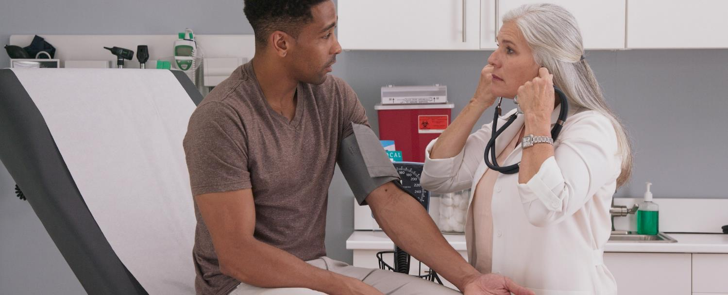
Health Effects: Adults
Increased blood pressure and incidence of hypertension
Decreased kidney function
Reproductive problems (in both men and women)
16
Notes:
Adults exposed to lead can suffer from:
Nerve disorders;
Increased blood pressure;
Decreased kidney function;
Reproductive problems; and
Memory and concentration problems.

Slide 17

Vulnerable Populations
  Pregnant and nursing people
17
Notes:
A pregnant person exposed to lead is of concern because it can result in exposure to the developing fetus. While most common in 1- and 2-year-old children, some pregnant people may also be exposed to lead from the intentional ingestion or mouthing of soil, clay or pottery, which is a behavior known as pica.
Instructor Note: Pica can be traditionally practiced among many cultures. Include if relevant for the community of interest. “Some women may also deliberately consume clay, soil, or rocks as part of their cultural practices. Pica can result in serious health effects to both the mother and her fetus if the clay, soil or rocks contain lead.”

Slide 18

Health Effects: Pregnant People
Lead can pass from the parent, exposing the fetus or breastfeeding infant.
Puts the parent at risk for miscarriage.
Baby may be born too early or too small.
Hurts the baby’s brain, kidneys and nervous system.
18
Notes:
Lead can accumulate in our bodies over time, where it is stored in our bones. During pregnancy, lead is released from the parent’s bones along with calcium and exposes the fetus or breastfeeding infant to lead. This occurs especially when the parent does not receive adequate dietary calcium, and can result in serious effects including:
Causing the baby to be born too early or too small;
Putting the mother at risk for miscarriage.
Hurting the baby’s brain, kidneys or nervous system; and
Increasing the likelihood of learning or behavioral problems.

Slide 19

Health Effects: Wildlife
Lead can also impact wildlife species, such as birds, mammals and amphibians.
Animals can be exposed to lead from mining, facility emissions and lead-based paint.
19
Notes:
Like humans, ingestion of lead in the food web can also impact wildlife species, such as birds, mammals and amphibians. Animals suffer negative consequences, that can impact their coordination, ability to hunt and eat and general health.
Animals can be exposed to lead from mining, facility emissions and lead-based paint. However, research indicates that ingesting lead fishing tackle and spent lead ammunition are two of the major sources of lead exposure and lead poisoning in wildlife.

Slide 20
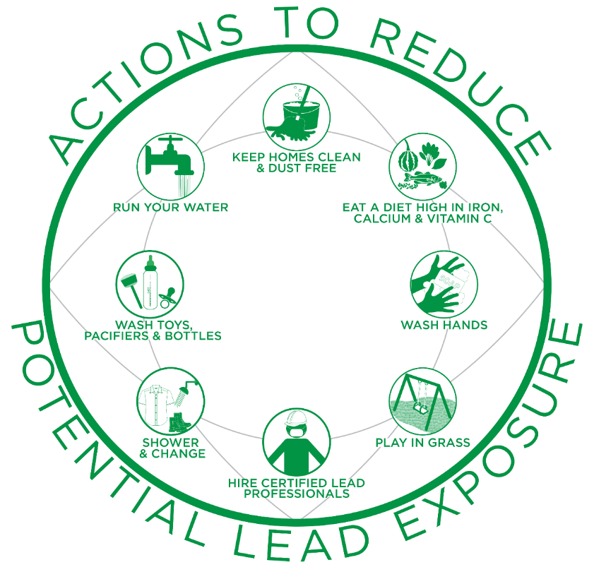
Taking Action
Lead exposure and lead poisoning is preventable!
20
Notes:
V. Taking Action
Lead exposure and lead poisoning is preventable!
Now we are going to continue our discussion of actions you can take at home to reduce your family’s potential exposure to lead.
Once again this infographic can be found on the front of your worksheet.

Slide 21

Keep Homes Clean & Dust-Free
Wet mop floors and hard surfaces.
Wipe down hard surfaces with a wet cloth.
Inspect and maintain painted surfaces.
Wet wipe peeling, chipping, chalking or cracking paint.
21
Notes:
a. Keep Homes Clean & Dust-Free
Wet mop floors and hard surfaces (e.g., porches) to minimize lead dust.
Wipe down hard surfaces such as countertops, window sills and doors jambs with a wet cloth.
Inspect and maintain all painted surfaces to guard against deterioration.
Wet wipe the area immediately if you notice any peeling, chipping, chalking or cracking paint. – It is important that you do not pick at or scrape the area and also remove a child’s access to the area.

Slide 22

Eat a Diet High in Iron, Calcium & Vitamin C
Wash food thoroughly with clean water prior to eating.
Do not eat food or drink water cooked or stored in chipped or cracked lead-crystal, lead-glazed pottery or lead-porcelain cookware.
22
Notes:
b. Eat a Diet High in Iron, Calcium & Vitamin C
Ensure family members eat a well-balanced diet of fruits, vegetables, grains, dairy and protein foods. Foods that are higher in calcium, iron and vitamin C can help reduce the absorption of lead. Children with healthy diets absorb less lead.
Wash all food thoroughly with safe water sources prior to eating. This helps to remove soil or lead dust that may have adhered to the surface of the food.
Do not eat food or drink water cooked or stored in chipped or cracked lead-crystal, lead-glazed pottery or lead-porcelain cookware.

Slide 23
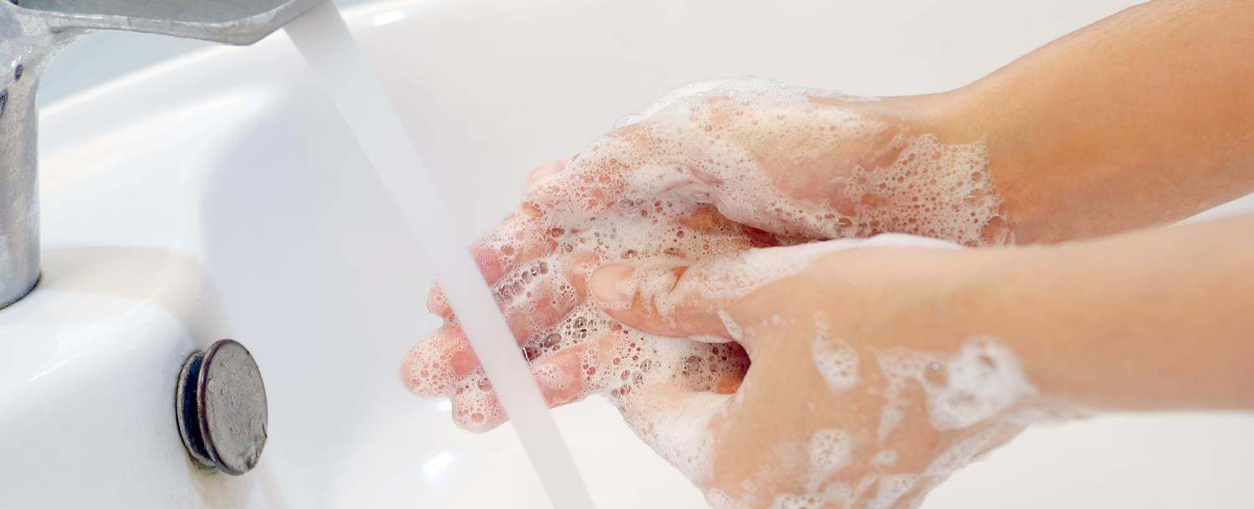
Wash Hands
Use soap and water (warm or cold) to wash children’s hands several times a day.
Adults should wash their hands after participating in activities in which they may have come in contact with lead.
23
Notes:
c. Wash Hands
Use soap and water (warm or cold) to wash children’s hands several times a day, especially after playing outside or with animals.
Adults should wash hands after participating in activities where they may have come in contact with lead.

Slide 24

Play in Grass
Play in grassy/non-contaminated bare soil areas.
Use designated picnic, camping & hiking areas.
Wipe, remove shoes and wash hands after playing outdoors.
Wipe off pet’s paws.
Place dust mats inside and outside your home.
24
Notes:
d. Play in Grass
Guide children to play in grassy or non-contaminated bare soil areas, especially if play areas are near roadways, junk yards, older buildings and uncontrolled or abandoned sites or properties.
Use designated picnic, camping and hiking areas.
Teach children to wipe and remove their shoes and to wash their hands after playing outdoors.
Wipe off pets’ paws prior to bringing them indoors.
Place dust mats both inside and outside your home.

Slide 25

Hire Certified Lead Professionals
Hire a certified lead professional for renovation and repair work on pre-1978 homes.
  www.epa.gov/lead/findacontractor
Or use do-it-yourself (DIY) lead-safe work practices to keep yourself and others safe
  www.epa.gov/lead/rrp-diyers
25
Notes:
While renovation projects can be fun and rewarding, they can also expose you and your family to lead if your home was built before 1978. Any renovation, repair, or painting (RRP) project in a pre-1978 home can easily create dangerous lead dust, which can harm children and adults.
Dangerous lead dust can be created when these surfaces are disturbed or demolished during RRP projects, increasing the risk of lead exposure. Because of this risk, EPA recommends owners of pre-1978 homes hire lead-safe certified contractors who are trained in lead-safe work practices for home renovations. People who perform renovations themselves should take simple precautions and use do-it-yourself (DIY) lead-safe work practices to keep themselves and others safe from potential lead exposure.
Visit epa.gov/lead/findacontractor to find a certified renovator near you or visit epa.gov/lead/rrp-diyers for information on DIY lead-safe work practices.

Slide 26
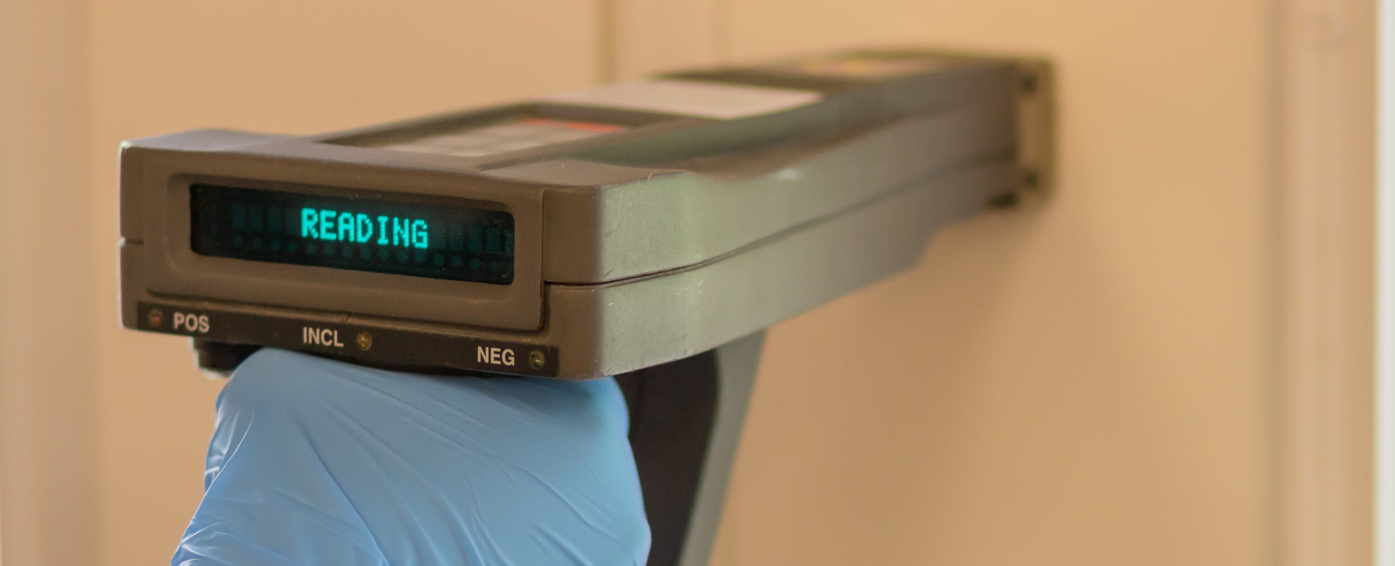
Hire Certified Lead Professionals
[Community Name] State Regulation:
Call [Community] helpline at [XXX-XXX-XXXX] for assistance
26
Notes:
[Insert state-specific information about their lead programs if the state or tribe has their own program]

Slide 27

Shower & Change
Clean or remove work clothes and shoes before entering your home.
Wash work clothes separately.
Shower after activities in which you may have been exposed to lead.
27
Notes:
f. Shower & Change
Clean or remove work clothes and shoes before entering your home to avoid tracking in lead from soil, work sites or hobbies. Store work clothes and shoes in a designated area outside the home.
Wash work clothes separately from other family members’ clothes.
Shower after participating in activities where you may have been exposed to lead to remove any lead dust from your skin and hair.

Slide 28

Wash Toys, Pacifiers & Bottles
Wash children’s pacifiers, bottles, and toys, like stuffed animals, often.
Do not let children chew on painted toys, window sills or other painted surfaces.
28
Notes:
g. Wash Toys, Pacifiers & Bottles
Wash children’s pacifiers, bottles, and toys, like stuffed animals, often.
Do not let children chew on painted toys, window sills or other painted surfaces.

Slide 29

Run Your Water
Before drinking, flush your home’s pipes by running the tap, taking a shower, doing laundry or washing dishes
Use a water filter that is certified to remove lead
Clean faucet screens regularly
29
Notes:
h. Run Your Water
Before drinking, flush your home’s pipes by running the tap, taking a shower, doing laundry or doing a load of dishes. The amount of time to run the water will depend on whether your home has a lead service line or not, and the length of the lead service line. Residents should contact their water utility for recommendations about flushing times in their community.
Use only cold water for drinking, cooking and making baby formula. Remember, boiling water does not remove lead from water.
Use a filter certified to remove lead.
Clean your faucet’s screen (also known as an aerator) regularly. Sediment, debris, and lead particles can collect in your aerator. If lead particles are caught in the aerator, lead can get into your water.

Slide 30

Run Your Water
Contact your water utility or a licensed plumber to:
  Determine if the pipe that connects your home to the water main (service line) is made from lead
    www.epa.gov/protectyourtap
  Test your water for lead
  Learn about lead levels in your drinking water
30
Notes:
Contact your water utility or a licensed plumber to determine if the pipe that connects your home to the water main (called a service line) is made from lead.
To help you determine if you have a lead service line bringing water into your home, visit epa.gov/protectyourtap.
Contact your water utility to have your water tested and to learn more about the lead levels in your drinking water.

Slide 31
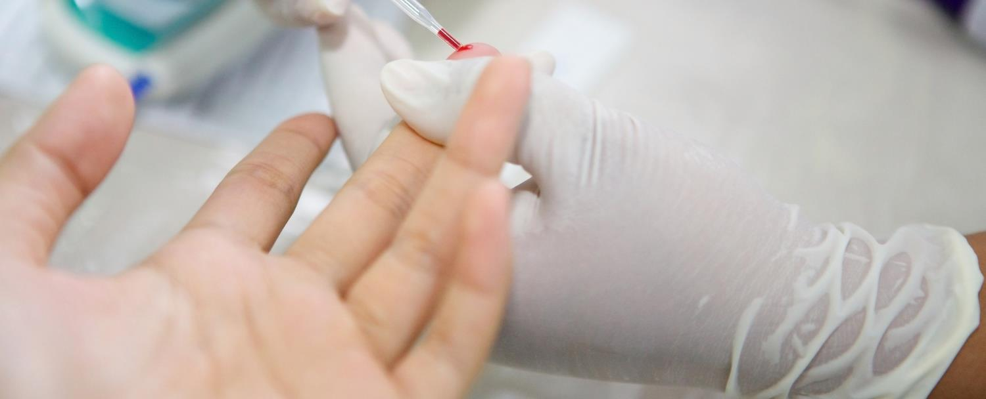
Getting Your Child Tested
Lead exposure often occurs with no obvious symptoms
A blood test is the only way to know if a child has lead in their blood
Testing is generally recommended at ages 1 and 2
31
Notes:
Raise your hand if your children or grandchildren have been tested for lead in the past.
The only way to know if a child has lead in their blood is to have a blood test.
Because lead exposure often occurs with no obvious symptoms, it frequently goes unrecognized.
No amount of lead is safe for children. It is generally recommended that children be tested at ages one and two.

Slide 32
Which of these actions do you think you will start using?
32
Notes:
Of all of the actions mentioned today, which of these do you think will be the easiest for you to take?, Which of these actions do you think will start using at home?
Please take a moment to think through all the actions we discussed and then write your answer on the bottom of your worksheet in the green box (Note: if writing utensils available)
Would anyone like to share what action or actions they plan on using?
As a reminder, your worksheet contains the infographic, which outlines the eight main actions.

Slide 33

Before You Buy or Rent
Before signing a lease or contract, homebuyers and renters have the right to know whether lead is present.
33
Notes:
Before we end today’s session, I want to share important information about the right of homebuyers and renters to know if lead is present before signing a lease or contract.
Federal law requires that anyone selling or renting pre-1978 housing provide specific information about lead-based paint and/or lead-based paint hazards before a contract or lease is signed. However, this is not required if the housing is:
For the elderly or persons with disabilities (unless a child under the age of 6 lives or is expected to live in such housing);
A zero-bedroom dwelling; or
If painted surfaces* have been declared lead-free.
*Instructor Note: If asked what is meant by painted surfaces in #3 that includes doors, windows, walls, any outbuildings, fences, signs, etc.

Slide 34

Federal Law Requires Buyers & Renters Receive
  A copy of the Protect Your Family From Lead in Your Home pamphlet
  Any information about the presence of lead-based paint and/or lead-based paint hazards
  Disclosure of information in or attached to the contract/lease
  Submit complaints to EPA at 1-800-424-5323
Notes:
Before signing a contract or lease for a pre-1978 home federal law requires that buyers and renters receive all of the following:
A copy of EPA’s Protect Your Family From Lead in Your Home pamphlet, which is available in multiple languages and shown here
Any known information about the presence of lead-based paint and/or lead-based paint hazards in the home or building
For multi-unit buildings, this includes report and records for common areas and other units from building-wide evaluations
A disclosure of information that is either attached to or included in the contract/lease that includes a “Lead Warning Statement” and confirms the seller or landlord have complied with all notification requirements
Buyers also have 10 days to conduct a lead-based paint inspection or risk assessment
If you are not provided this information, ask for it. You can also submit a complaint to EPA by calling the National Lead Information Center at 1-800-424-LEAD [5323].
Instructor note: The “Protect Your Family” pamphlet is available in 12 different languages, both in color and black and white and can be provided to buyers and renters either in print or digitally.

Slide 35

Conclusion
We discussed:
  Potential sources of lead exposure.
  How lead harms children and adults.
  Lead’s impacts on the environment and wildlife.
  Actions that can be taken to prevent potential lead exposure.
35
Notes:
VI. Conclusion
Today we discussed sources of lead exposure; how lead harms children and adults; its impacts on wildlife; and actions that we can take to prevent potential exposure to lead.

Slide 36
What questions do you have about the information we covered today?
36
Notes:
Today was meant to be an introduction to lead. What questions do you have about the information we covered today?
Raise your hand or shout it out!

Slide 37
National Lead Information Center
1 (800) 424-LEAD [5323]
Ask for information about lead, lead hazards and lead exposure prevention.
Monday to Friday, 8:00 am to 6:00 pm ET (except federal holidays).
Hearing- or speech-challenged individuals may access this number through TTY by calling the Federal Relay Service at 1-800-877-8339.
37
Notes:
If you have any questions after the session today or want more information about lead, you can contact the National Lead Information Center (or NLIC) using this toll free number.
The NLIC provides the public and professionals with information about lead, lead hazards and lead exposure prevention. You can also call NLIC to file a complaint about your landlord or a contractor if they are not following the federal laws about lead mentioned earlier. Call to speak with a specialist Monday through Friday, 8:00 am to 6:00 pm Eastern time (except federal holidays) at 1 (800) 424-LEAD [5323]. If its helpful you may also accessyou may also access this number through TTY by calling the Federal Relay Service at 1-800-877-8339.
Instructor Note: Participants can find this number on both the worksheet and key messages.

