Slide 1
DELETE THIS SLIDE PRIOR TO PRESENTATION
This PowerPoint serves as a template presentation which introduces topics related to air quality and is part of a suite of presentations provided by the EPA for the Megacities program.
See speaker notes for an additional description of slide content. Slides should be edited or added to as necessary for your particular needs. Slides with highlighted yellow text require the addition of specific context and information for your city.

Slide 2
Public Involvement

Slide 3
Overview
1. Introduction
2. International Standards
3. Principles of Public Involvement
4. Steps for Effective Public Involvement

Slide 4
Section 1: Introduction
1. Introduction
2. International Standards
3. Principles of Public Involvement
4. Steps for Effective Public Involvement

Slide 5
Air Quality Management Planning
Public Participation
Air Quality Goal Setting
Air Pollution Control Strategies
Air Quality Monitoring
Impacts of Air Quality
Legislation, Regulation, and Implementation
Air Quality Modeling
Emissions Inventory
Compliance and Enforcement
Human and Environmental Assessment
Air Quality Data
Notes:
Public participation is an overarching process in air quality management planning. In every step of the process, from developing monitoring systems in your city to setting air quality goals, public participation can and should be incorporated. Public involvement can bring more knowledge to the table, addresses social and economic needs, and increase community ownership and compliance.

Slide 6
What is [YOUR CITY] Doing Now?
Do you regularly involve the public in air quality decision making? If so, how?
What has been successful? Why?
What has been less successful? Why?
What will be the best public engagement strategy for air quality management planning?
Who needs to be involved?
What planning is needed to be successful?

Slide 7
Rio Declaration
Universal principles developed at UN Conference on Environment and Development (Rio 1992):
  Environmental issues should prioritize public participation
  The public should have appropriate access to information
  States should encourage public awareness and participation
Notes:
UN Conference on Environment and Development met in Rio in June 1992
Principle 4: To achieve sustainable development, environmental protection shall constitute an integral part of the development process and cannot be considered in isolation from it.
Principle 10: Environmental issues are best handled with the participation of all concerned citizens at the relevant level. At the national level, each individual shall have appropriate access to information concerning the environment that is held by public authorities, including information on hazardous materials and activities in their communities, and the opportunity to participate in decision-making process. States shall facilitate and encourage public awareness and participation by making information widely available. Effective access to judicial and administrative proceedings, including redress and remedy, shall be provided.

Slide 8
Bali Guidelines
Tool to assist countries in filling gaps in national and sub-national legislation
Focuses on:
  Access to information
  Public participation
  Access to justice in environmental matters
Complete Guidelines at http://wedocs.unep.org/handle/20.500.11822/11182
Notes:
Implementing Principle 10 - Guidelines for the Development of National Legislation on:
Access to information
• Openness and transparency in decision making
• More efficient and effective environmental regulations
Public participation
• Informed citizen participation
• Mechanism for integrating citizen concerns into public policy making
• Enhanced ability of governments to respond to public concerns and demands, build consensus, improve acceptance of and compliance with environmental decisions
• Build ownership of the decisions
Access to justice
• Protecting the rights to access o information and participation
• Questioning decisions
• Competent legal bodies to protect environmental rights
• Independent and expeditious judicial processes for environmental damage

Slide 9
Multilateral Agreements
Examples of Multilateral agreements that support participation and environmental justice:
  AARHUS Convention (1998)
  Malmo Declaration (2000)
  Inter-American Strategy for the Promotion of Public Participation in Sustainable Development in Decision Making (2001)
Notes:
AARHUS: United Nations Economic Commission for Europe (UNECE) adopted to establish a number of rights of the public in regard to the environment:
- right of everyone to receive environmental information that is held by public authorities
Right to participate in environmental decision-making
Right to review procedures to challenge public decisions that have been made
Malmo declaration: “The role of civil society at all levels should be strengthened through freedom of access to environmental information to all, broad participation in environmental decision-making, as well as access to justice on environmental issues. Governments should promote conditions to facilitate the ability of all parts of society to have a voice and to play an active role in creating a sustainable future.”
Inter-American Strategy for the Promotion of Public Participation in Sustainable Development in Decision Making (2001) is a report developed by the Organization of American States

Slide 10
Reasons for Public Involvement
Increases community ownership and compliance
Perceived as a fairer process
Reduces litigation
Addresses misunderstandings
Addresses social and economic needs of affected parties
Fosters better relationships and builds partnerships
Expands your skill base and produces more creative solutions
Reality and practicality check
Technically superior options
Better environmental outcomes!

Slide 11
Principles of Public Involvement
Respond to needs and priorities of the public
Increase public understanding
Increase legitimacy and accountability
Communicate how public input affects the decision
Notes:
People should have a say in decisions that affect their lives
Includes the promise that the public’s contribution will influence decisions
Communicate the interests of the participants and meet their process needs
Seek out and involve those potentially affected
Participants help define how they participate
Provide participants with the information needed to participate in a meaningful way
Communicate to participants how their input affected the decision

Slide 12
Choosing Levels of Public Participation
Not all decisions or issues require extensive public participation; policymakers should consider:
  The degree to which the public considers the issues significant
  The potential impacts to the public
  The level of existing controversy
  The required level of public participation, whether by law or regulation
  Possible benefits of involving the public
Notes:
Example: choosing where to implement 3 air quality monitors at different spots in the city
Public may consider this issue significant if they are concerned about a pollution hotspot near their residence
Final decision could have an impact on actions taken to reduce air pollution near peoples’ homes
May not be a high level of controversy, but still of interest to the public
Could open public comment or hold a forum
Involving the public also brings benefits, as it can allow for crowd-sourcing of potential pollution hotspots in the city

Slide 13

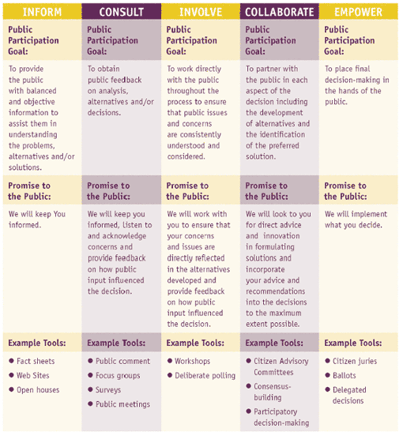
Choosing Levels of Public Participation
https://www.iap2.org/page/pillars
Notes:
Different levels of public participation can have different impacts on the public, and they can be matched to the potential impact of proposed actions
Promises to the public can range from keeping the public informed to giving decision-making power to the public
Tools can range from fact sheets to ballots and delegated decisions

Slide 14
Steps for Effective Public Involvement
Plan and budget for public involvement activities
Identify the interested and affected public
Consider providing technical/ financial assistance
Provide information and outreach
Conduct public consultation/involvement activities
Review and use input and provide feedback
Evaluate public involvement activities

Slide 15
Step 1: Plan and Budget
Public involvement is a process, not an event
Budget sufficient resources
Start early
“Fit the forum to the fuss”; choose the right level of public participation
Obtain the right type of skilled help
Follow through on commitments

Slide 16
Step 2: Identify the Affected Public
Do research
Communicate and publicize
Use appropriate language and media
Build contacts and partnerships

Slide 17
Step 3: Technical Assistance
Some groups and individuals will need resources in order to participate effectively
Research different groups’ needs and potential barriers to involvement
Get creative and look for low-cost options
Develop tools for the public
Look for partners

Slide 18
Step 4: Provide Information and Outreach
Give accurate information early and often in accessible places
Understand the audience
  How they prefer to receive information
  Their trusted sources
  Their history with the issue
Find community contacts
Practice transparency

Slide 19
Step 5: Conduct Involvement Activity
Activity as appropriate based on agency’s needs and public’s needs
Work your plan
  Prepare easily understood materials
  Line up the resources and help you need
  Publicity
  Convenient time and place
  Encourage participation of under-represented groups

Slide 20
Step 6: Review and Give Feedback to Public
Respect and use input to earn trust and credibility
Use input where appropriate and possible
Tell the public about the decision and how public input affected the decision

Slide 21
Step 7: Evaluate
Communication planning is key at the beginning and the end
Review, use input, and provide feedback
Evaluate public involvement activities

Slide 22
Summary
Public involvement leads to better decisions and more successful program implementation
Most international organization recognize the needs for and benefits of investing in public involvement
Takes planning and budgeting
There are many resources available to help

Slide 23
Resources for Public Involvement
EPA’s Public Participation Guide
https://www.epa.gov/international-cooperation/public-participation-guide
International Association for Public Involvement Web site
http://www.iap2.org/
The Access Initiative
http://www.accessinitiative.org/
Implementing Principle 10 and the Bali Guidelines
https://www.unenvironment.org/civil-society-engagement/partnerships/principle-10
Southern African Institute for Environmental Assessment Handbook One Stop Participation Guide https://irp-cdn.multiscreensite.com/2eb50196/files/uploaded/handbook.pdf
Aarhus Clearinghouse for Environmental Democracy
http://aarhusclearinghouse.unece.org/

Slide 24
Thank you!

