Slide 1
DELETE THIS SLIDE PRIOR TO PRESENTATION
This PowerPoint serves as a template presentation which introduces topics related to air quality and is part of a suite of presentations provided by the EPA for the Megacities program.
See speaker notes for an additional description of slide content. Slides should be edited or added to as necessary for your particular needs. Slides with highlighted yellow text require the addition of specific context and information for your city.

Slide 2
Air Quality Modeling

Slide 3
Air Quality Modeling Uses
Air quality modeling helps to estimate the relationship between sources of air pollution and their effects on ambient air quality
  Identify source contributions
  Design effective air quality strategies
Predicts impact from new or proposed emissions sources
Simulates ambient pollutant concentrations under different air quality policy scenarios
Tracks trends
Assesses compliance

Slide 4
Applications of Air Quality Models
Air quality modeling is resource intensive
  Requires staff with time and knowledge of how to use the model itself
Can present information for a snapshot in time
  Useful for understanding a certain policy scenario if a future policy or past counterfactual scenario is modeled

Slide 5
Requirements
Air quality models require detailed data inputs:
Emissions information
  Emissions inventory
  Source characteristics
    Location, stack height, source type, exit velocity, release rate
Meteorological conditions
  Wind speed, wind direction, temperature, humidity, mixing height
Topography
  Receptor locations
  Obstructions
Secondary atmospheric chemistry processes

Slide 6
Sources
Point Sources
Area Sources
Mobile Sources
Power or chemical plant stacks
Cook stoves
On-road vehicles
Waste burning
Off-road vehicles
Ships

Slide 7
Types of Air Quality Models
Dispersion Model
Used in permitting processes to estimate the pollutant concentrations at specified ground-level receptors surrounding an emissions source​
Photochemical Model
Used in regulatory or policy assessments to simulate impacts from all sources by estimating pollutant concentrations and deposition of both inert and chemically reactive pollutants over large spatial scales​
Receptor Model
Observational techniques that use chemical and physical characteristics of gases and particles measured at source and receptor locations to identify presence of pollutant and quantify source contributions to pollutant concentrations at receptor ​locations
Reduced Form Model
Use limited input information to approximate photochemical models
https://www.epa.gov/scram/air-quality-models

Slide 8
What Does an Air Quality Model Do?
Uses mathematical and numerical techniques to simulate air pollutant transport and transformation (e.g., through chemical reactions).
Characterize dispersion of directly emitted primary pollutants (e.g., NOx, VOCs) and secondary pollutants (e.g., Ozone) that are formed in the atmosphere.
Inputs include: ​
  Meteorological data ​
  Emission rates and stack height
Notes:
Air quality models use mathematical and numerical techniques to simulate the physical and chemical processes that affect air pollutants as they disperse and react in the atmosphere​
Characterize dispersion of primary pollutants that are emitted directly into the atmosphere and, in some cases, secondary pollutants that are formed as a result of complex chemical reactions within the atmosphere​

Slide 9
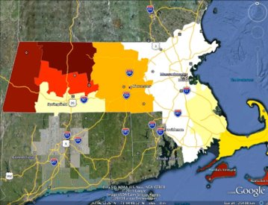
How Are Air Quality Models Used?
Estimate exposure to pollutants​
Identify current pollutant source contributions
Design effective pollution reduction strategies​
Estimate future source contributions and concentration impacts before implementing a new regulatory program
Monitors (dots) are sparse even in populated areas, and models help fill in unmonitored areas

Slide 10
Meteorological Data
Required meteorological inputs vary by air quality model, but usually include information regarding:​
Wind speed and direction​
Vertical mixing​
Temperature and atmospheric moisture​
Two main sources of inputs:​
  Observational Meteorological Data
  Meteorological Grid Models
Photochemical models require more inputs than dispersion models
Notes:
Two main sources of inputs:​
Observational Meteorological Data: Physical parameters that are measured directly by instrumentation​
Meteorological Grid Models: Models that use mathematical formulations to simulate atmospheric processes such as the change of winds and temperature in time over an area or interest​

Slide 11
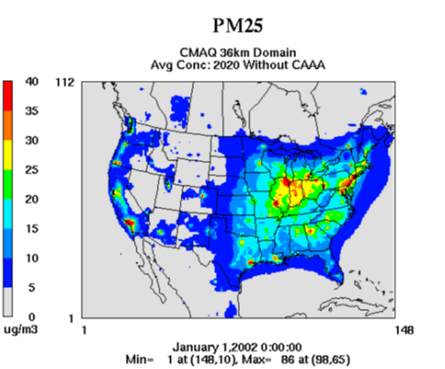
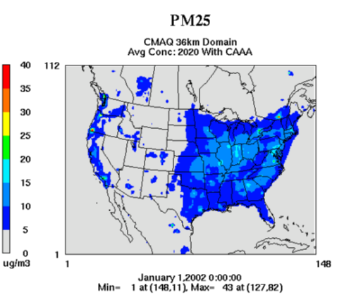
Example: Continental Scale AQ Model
More example results for the US​: https://www.epa.gov/cmaq/cmaq-output​
Notes:
These slides show PM2.5 estimates over the US created by a photochemical model, CMAQ (community multiscale air quality model, which is a preferred EPA chemical model). The figure on the left shows the PM2.5 concentrations for a counterfactual 2020 scenario without the Clean Air Act Amendments, while the figure on the right shows the modeled value for 2020 air quality with the CAAA (meant to represent reality).

Slide 12
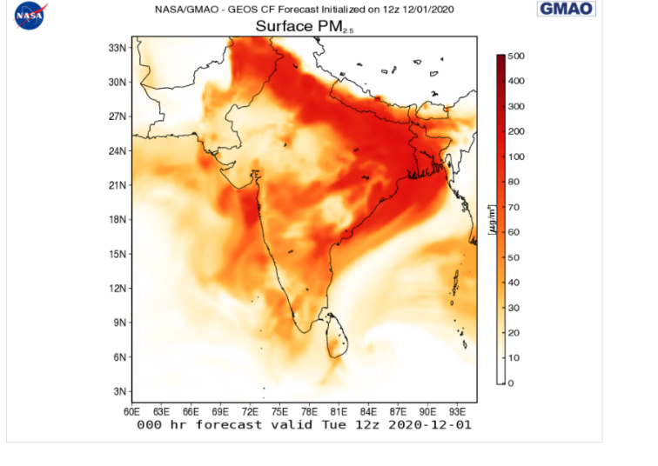
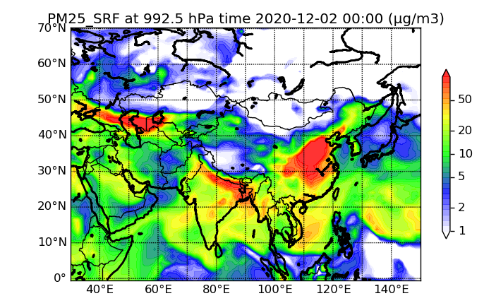
Photochemical Forecasts Available Globally
NASA GEOS-CF
NCAR WACCM
https://fluid.nccs.nasa.gov/cf/
https://www.acom.ucar.edu/waccm/plot.shtml

Slide 13
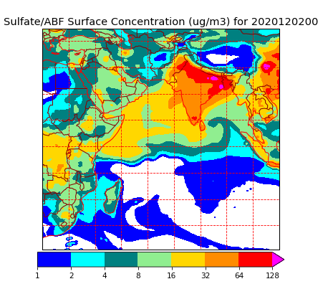
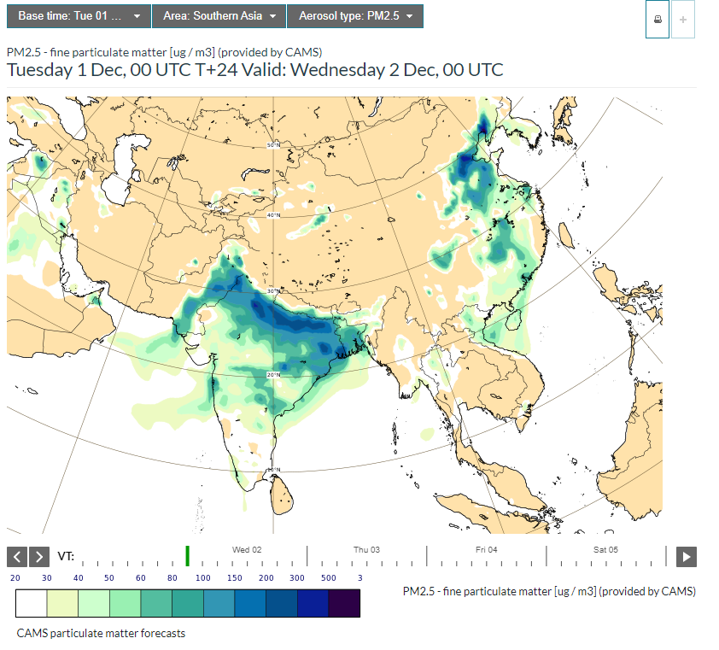
Photochemical Forecasts Available Globally
Navy Aerosol Analysis and Prediction System Global Aerosol Model
CAMS Particulate Matter Forecast
https://www.nrlmry.navy.mil/aerosol/
atmosphere.copernicus.eu/charts/cams/

Slide 14
Thank you!

